Slide 1
Researching Federal Congressional
Committee Hearings

Slide 2
Overview
Background
Hearings in the legislative process
Types of Committees
Types of Hearings
Publication of Hearings
Doing Hearings Research
What information should be collected beforehand?
What resources do you use and how do you use them?

Slide 3
Background Information

Slide 4
Federal Legislative Process
Bill Introduced
Referred to Committee
Hearing
Markup
Reported to Floor
Debate
Amendments
Vote
Engrossed
Reported to Other Chamber
Referred to Committee
Hearing
Markup
Reported to Floor
Debate
Amendments
Vote
Engrossed
Referred to Conference Committee
Chamber Differences Resolved
Reported to Floor
Debate
Vote
Enrolled
Presented to President

Slide 5
Congressional Committees
Types of Committees
Standing Committees
Currently 20 House Committees and 16 Senate Committees
Look to House and Senate Rules for jurisdictional statements
Special/Select Committees
Currently 5 House and 4 Senate Committees
Created by resolution to focus on a particular topic, not permanent
Joint Committees
Currently 4 – Library, Economic, Printing, and Taxation
Made up of House and Senate Members
Source: https://www.loc.gov/item/2020630740/

Slide 6
Committee Hearings: Types
General Types
Oversight
Investigative
Legislative
Senate Only
Confirmation
Ratification

Slide 7
Congressional Committees
For more information:
Congress.gov
Committees Page - https://www.congress.gov/committees
govinfo
House Rules and Manual - https://www.govinfo.gov/app/collection/hman
Senate Manual - https://www.govinfo.gov/app/collection/sman
House
Committee Profiles - https://clerk.house.gov/committees
House Committees: Fast Facts - https://history.house.gov/Education/Fact-Sheets/Committees-Fact-Sheet2/
Senate
Committee Assignments - https://www.senate.gov/general/committee_assignments/assignments.htm
Frequently Asked Questions - https://www.senate.gov/committees/committees_faq.htm

Slide 8
Publication of Hearings

Slide 9
Committee Hearings: Published vs. Unpublished
Committees can decide to not publish a hearing
If a hearing is “unpublished,” you still might be able to find a copy of the transcripts or a video of the hearing via:
Print Resources
CIS Unpublished US House of Representatives Committee Hearings (1833-1972)
CIS Unpublished US Senate Committee Hearings (1823-1964)
Online Resources
Pre-published Hearing Transcripts in subscription databases like ProQuest Congressional or CQ.com
Congress.gov (selected from early 2000s-present)
Committee Websites
C-SPAN (selected videos from 1986-present)
House Committee Repository (selected from 2009-present)

Slide 10
Committee Hearings: Publication
Published by the committee, not the Chamber, so publication practices vary
Typically published within a year, but some hearings might take several years
Hearings typically include:
A table of contents with witness identification information,
Pre-prepared statements,
An edited transcript of testimony, and
Other supplemental information

Slide 11
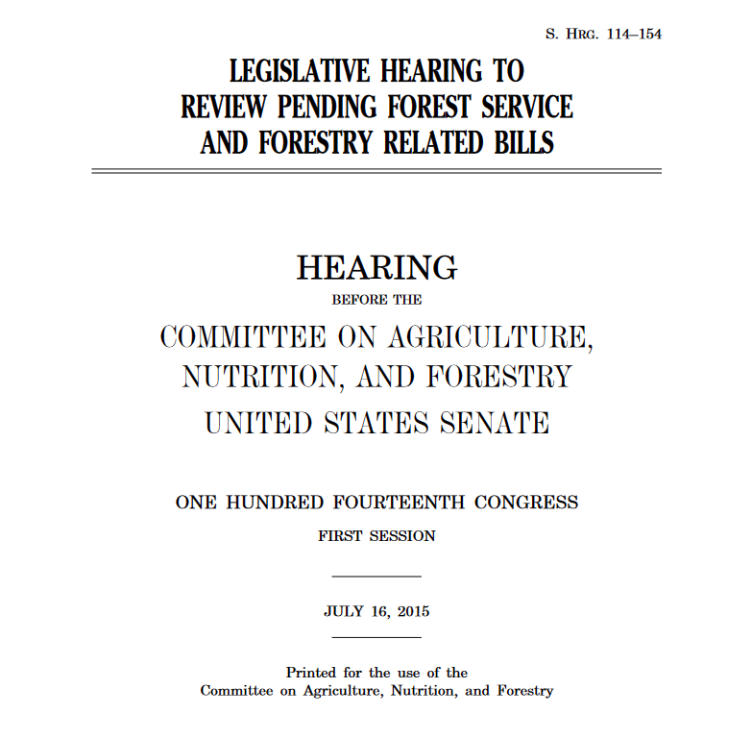
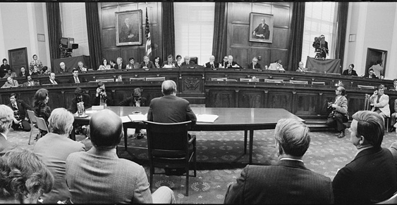
Committee Consideration: Hearing
Legislative Process
Committee Holds Hearings
Information Created
Published Hearing

Slide 12
Committee Hearings: Citation
Legislative Hearing to Review Pending Forest Service and Forestry Related Bills: Hearing Before the S. Comm. on Agric., Nutrition, and Forestry, 114th Cong. 5-6 (2015) (statement of Robert Bonnie, Under Sec’y, Nat. Res. & Env’t, U.S. Dep’t of Agric.).
Title of Hearing (including (sub)committee information)
Number of Congress
Page Numbers
Date
Parenthetical Information about what is occurring on those pages

Slide 13
Congressional Consideration: Markup
A “meeting” that is held when Members in a committee or subcommittee offer and vote on amendments to a bill
Held after the hearings stage
Committee can decide to report out an new or clean bill, which is a bill that was essentially written in the markup process itself from a draft proposal
Where to find information about markup sessions
Not typically published, but can:
be appended to a committee hearing on the same legislation/topic, or
be published as a “print” from that committee
Subscription Resources (separate markup reports, depending on subscription):
CQ.com
NexisUni/Lexis

Slide 14
Doing Hearings Research: Where to Begin

Slide 15
Legislative History: Where to Begin
Where you begin with your legislative history compilation depends on your first point of reference:
Popular name of a law
Public Law number
United States Code citation
Ultimately, to get the most information, you will want to determine the number of the bill or resolution that gave rise to the law in which you are interested

Slide 16
Publication of Federal Statutes
Slip Law
Statutes at Large (session laws)
United States Code
Legislation published individually as it is enacted
Chronological arrangement of public and private laws exactly as they have been enacted
A “continually updated, subject arrangement of public laws, of a general and permanent nature, currently in force”
Any amendments from session laws have been consolidated and any repealed laws eliminated
Typically published in pamphlet or soft-bound form
Published in hardbound volumes and online
Published in hardbound volumes and online
Enrolled Bill

Slide 17
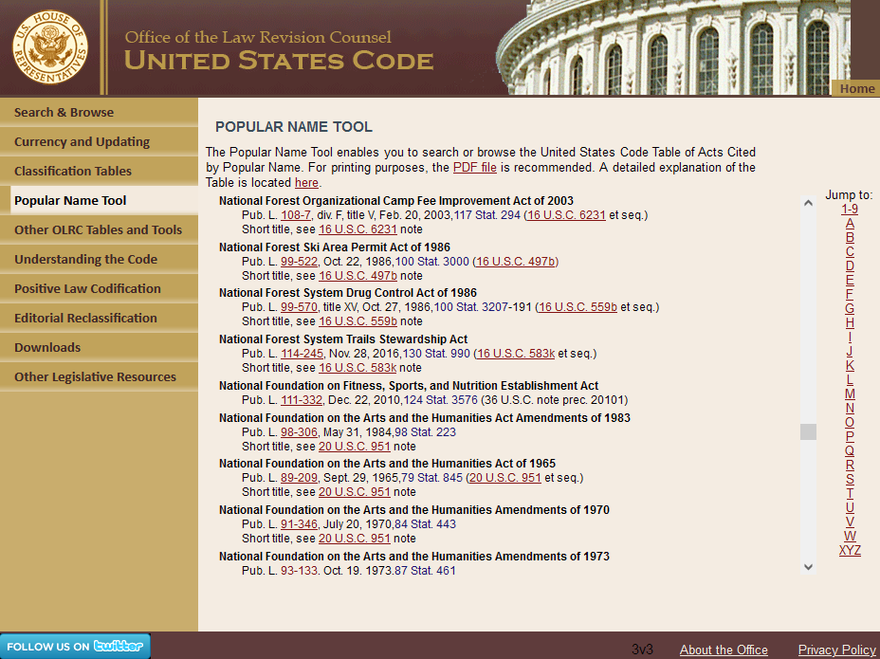
Starting with a Popular Name Online
The House Office of the Law Revision Counsel U.S. Code website-- http://uscode.house.gov--provides a helpful Popular Name Tool
Subscription databases allow you to search by popular name as well

Slide 18
Review: Citation of Public Laws
Public Law Citation
Pub. L. 114-245
U.S. Statutes at Large Citation
130 Stat. 990
# of Congress
# of Law in Sequential Order
Volume #
Page #

Slide 19
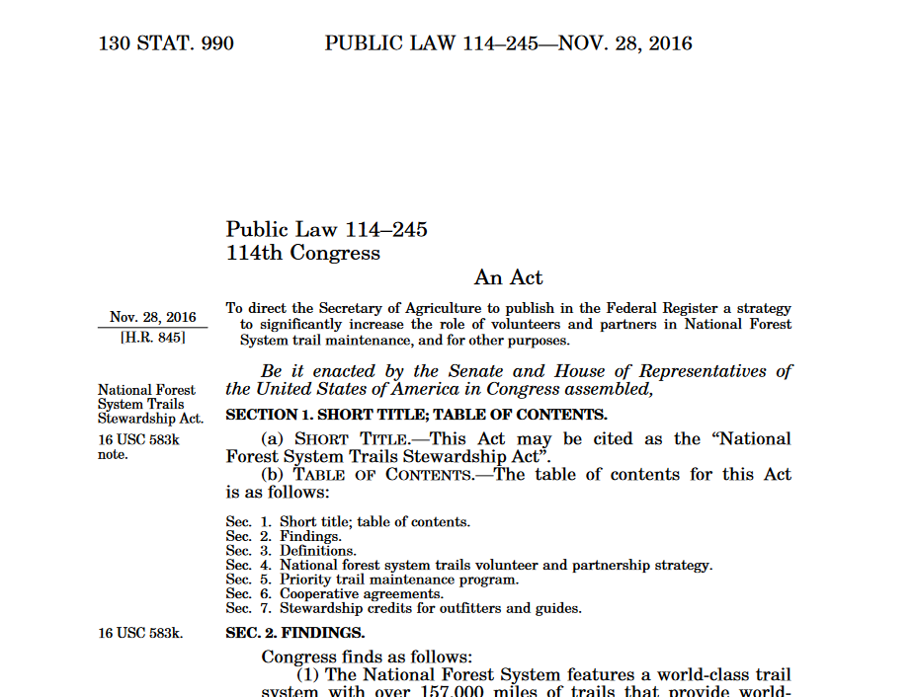
Review: Information Found in Statutes at Large
Statutes at Large citation
Public Law #
# of Bill that became this Public Law
Short Title information

Slide 20
Public Laws: Online Sources
Free Sources
govinfo (1951-present)
https://www.govinfo.gov/app/collection/STATUTE (1951-2014)
https://www.govinfo.gov/app/collection/PLAW (1995-present)
Law Library of Congress (1789-1950) - http://www.loc.gov/law/help/statutes-at-large/index.php
Century of Lawmaking for a New Nation (1789-1875) - http://memory.loc.gov/ammem/amlaw/lwsllink.html
Congress.gov (1951-present) - https://www.congress.gov/public-laws/
Subscription Sources in the Law Library
Westlaw & Nexis Uni
HeinOnline (1789-2014)
ProQuest Congressional (1789-present, approx.)

Slide 21
Doing Hearings Research: Using Free and Subscription Resources

Slide 22
Free Online Congressional Hearings Resources
Congress.gov (http://www.congress.gov)
Congressional actions regarding bills and resolutions (1973-present)
Congressional Record (1904-present in PDF)
Congressional Committee Hearings (1993-present)
Congressional Research Service Reports (approx. 2000-present)
Govinfo (http://www.govinfo.gov)
Selected Hearings (1955-present)
Selected Congressional Documents (1975-present) and Prints (1975-present)
Congressional Record (Bound: 1873-2016; Daily: 1994-present)
House Document Repository (2009-present, http://docs.house.gov)
A Century of Lawmaking for a New Nation (1774-1875, http://memory.loc.gov/ammem/amlaw/lawhome.html)
Committee Websites

Slide 23
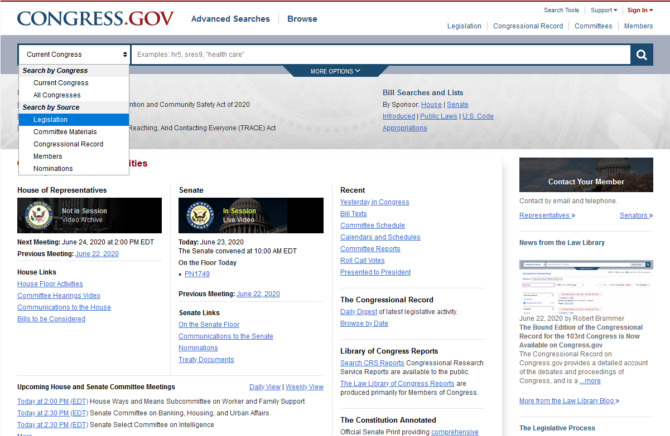
Using Free Sources - Congress.gov Homepage
Help features found under “Support”
Account information found under “Sign In”
Congress.gov has a global search option, where you can choose which resource you would like to search.
Then enter keywords, bill number, short title, or citation into the search box and hit enter.

Slide 24
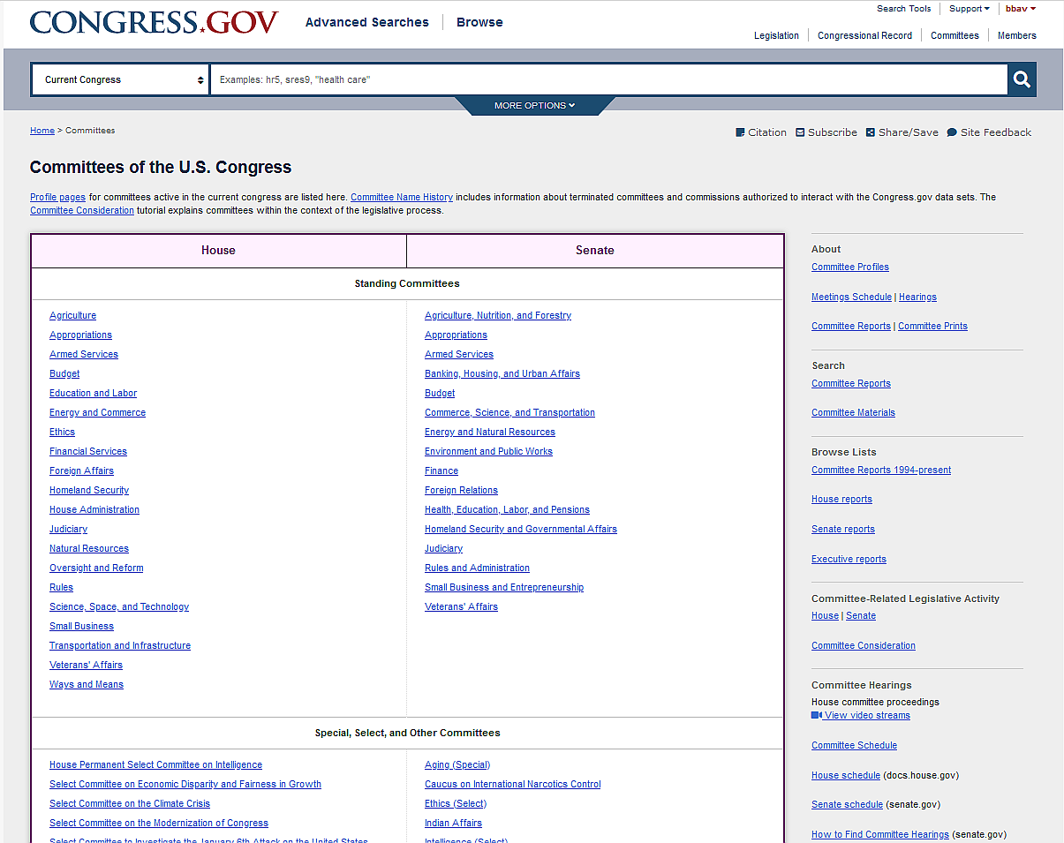
Using Free Sources - Congress.gov Committees Page
If you want more information about congressional committees, select the “Committees” link at the top of the page.
Here you’ll find links to committee landing pages and information about where to find hearing videos.

Slide 25
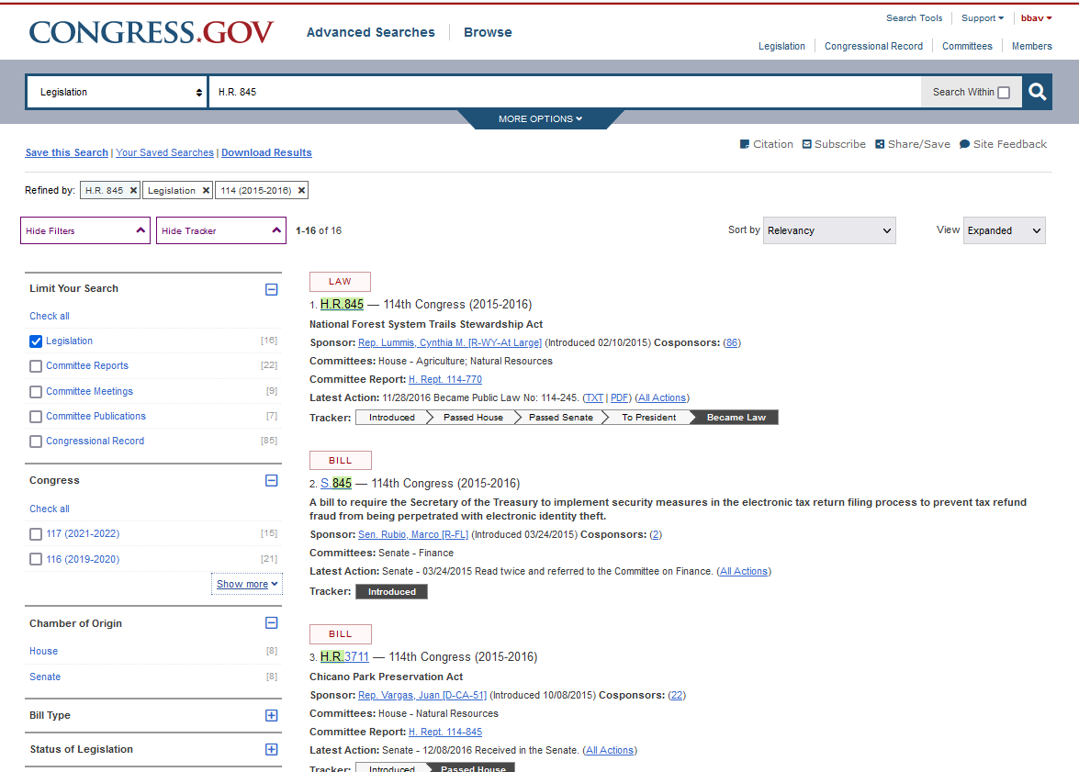
Congress.gov – Legislation Search
Use the Facets to narrow down your results – by Congress, by status of the legislation, etc.
Click the bill number to open up the bill’s “Bill Summary and Status” page

Slide 26
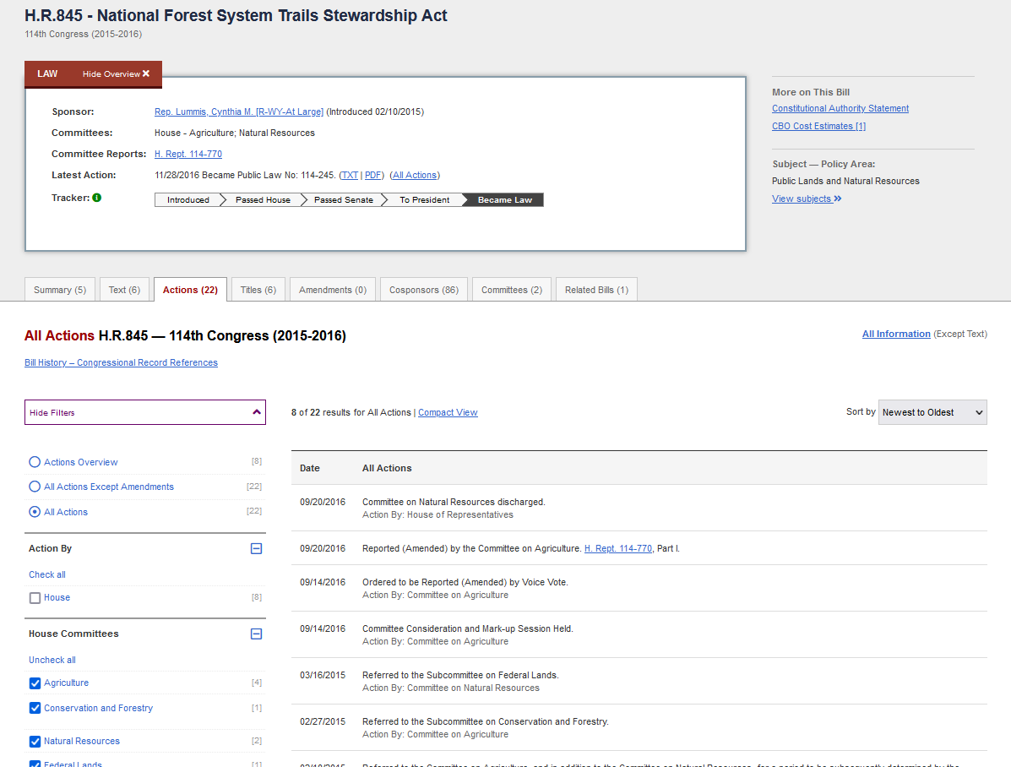
Congress.gov – Actions Tab
If you select the “Actions” tab, then the “All Actions” link, you will get a listing of everything that happened to the bill as it moved through Congress, and can limit to committee actions
In addition, find links to congressional hearings and reports (where available)

Slide 27
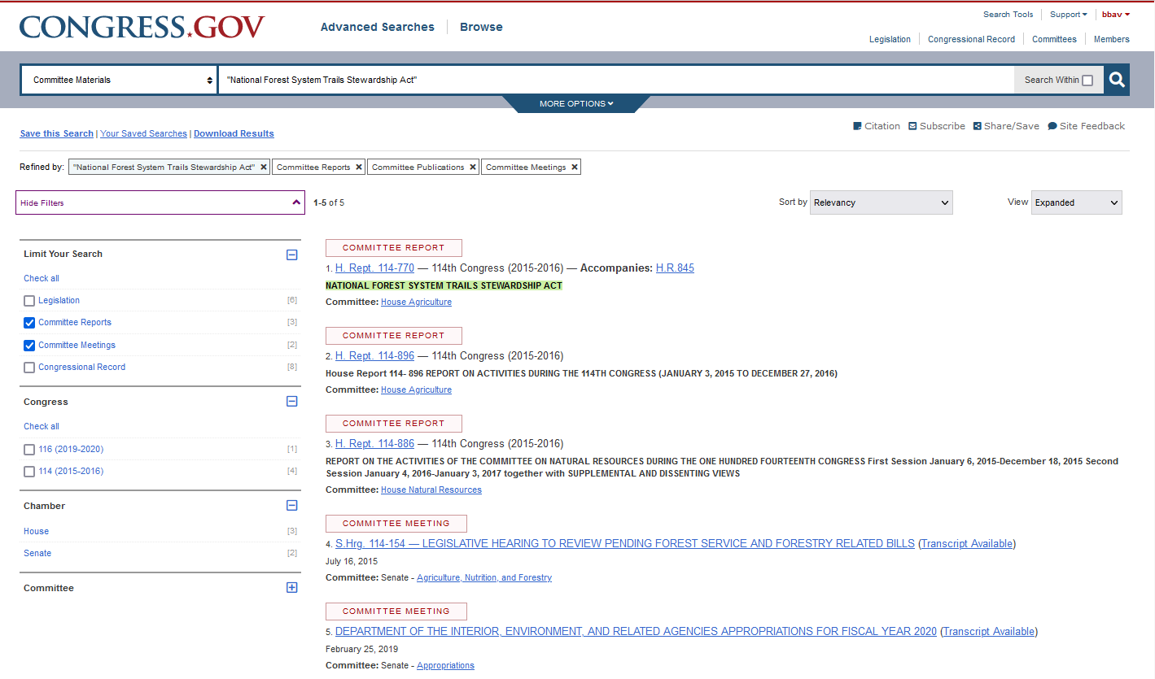
Congress.gov – Committee Materials Search
You can also search for committee hearings and reports directly by keyword using the global search box and selecting “Committee Materials” from the drop-down menu.

Slide 28
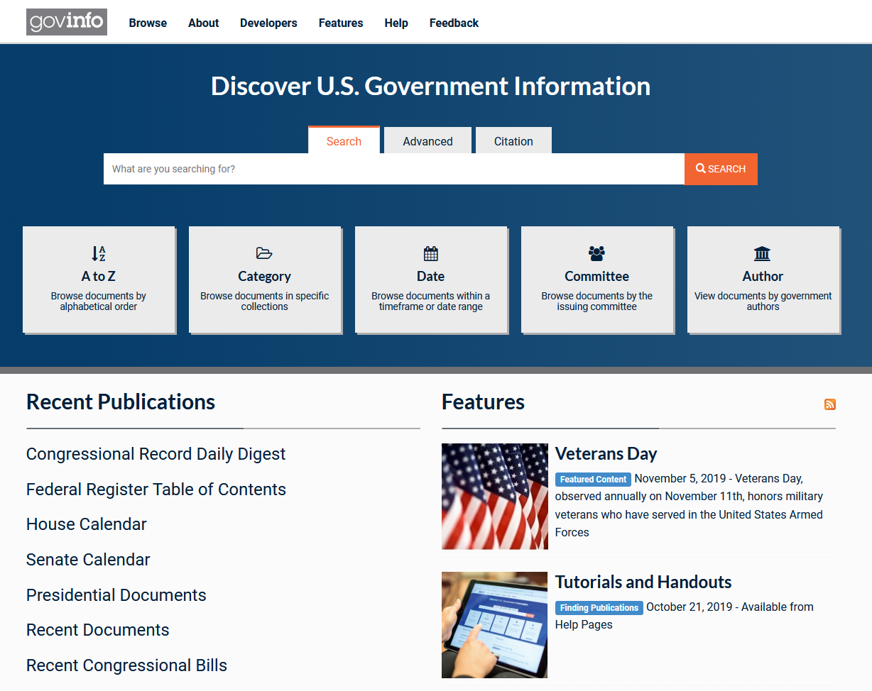
Using Free Sources – Govinfo
If you have a citation, you can:
(1) use the alphabetical browse to find the resource; or (2) use the “Citation” tool to be taken directly to the page(s) cited (only for selected resources, though)
If you do not have a citation, you can do a keyword search. Use the “Advanced” tool rather than the global search, however!

Slide 29
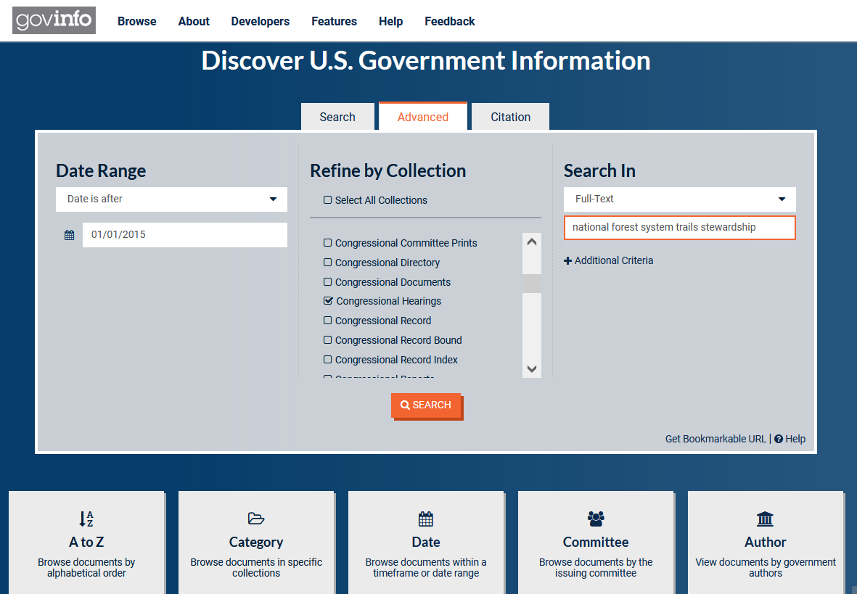
Govinfo – Advanced Search
To do an advanced search, simply input a date range, select a collection (or collections—you can select more than one collection to search at once), and add your keywords to the “Search In” box.

Slide 30
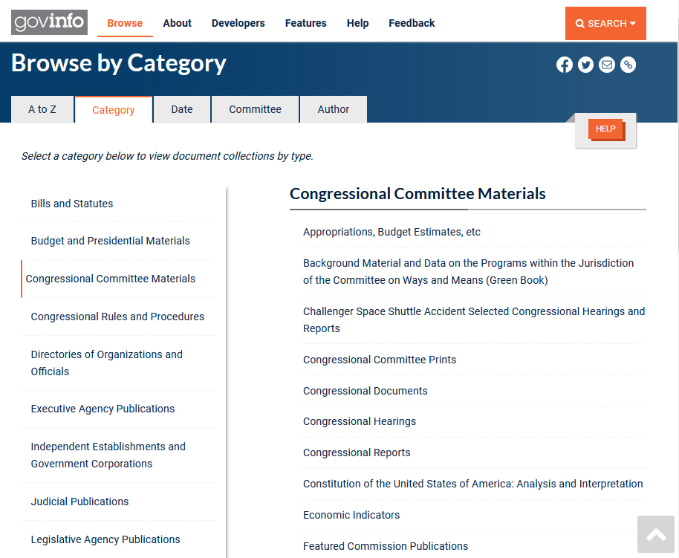
Govinfo – Browse by Category
If you select “Category Browse,” you can find resource collections listed (and linked) by topic area. Of particular interest to us is “Congressional Committee Materials”

Slide 31
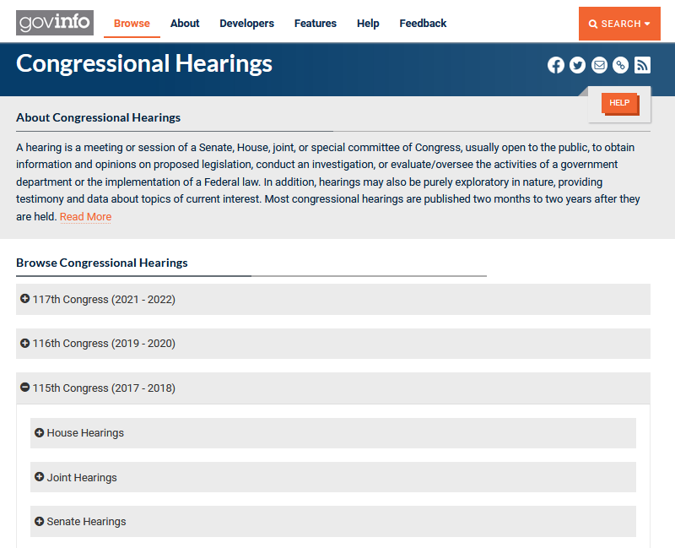
Govinfo – Browse Collections
If you select a collection from a Browse List, the collection will typically be broken down by Congress, by chamber (House, Senate, and Joint, in some cases) and committee, and then either chronologically or by number.

Slide 32
What if all I have is a citation to a committee hearing?
If the hearing was published in or after 1995, consider first checking your free online resources
govinfo has selected hearings, browsable by Congress/year, type of report/hearing, and citation
You can also search for committee hearing information on Congress.gov!
If the hearing was published after the late 1800s and before 1995, consider checking subscription databases
ProQuest Congressional has hearings and reports, searchable by number and keyword
* Exception here for selected hearings from 1955 to present, available on govinfo!
For legislative history documents published before the late 1800s, you can try a hybrid approach
Selected legislative history documents are available through our “A Century of Lawmaking for a New Nation” website
For documents not available online, we may have to turn to print-based and microform resources—don’t worry, librarians can help!

Slide 33
Congressional Hearings - Subscription Sources
ProQuest Congressional (1969-present)
ProQuest Legislative Insight (1789-present)
HeinOnline (1789-2020)

Slide 34
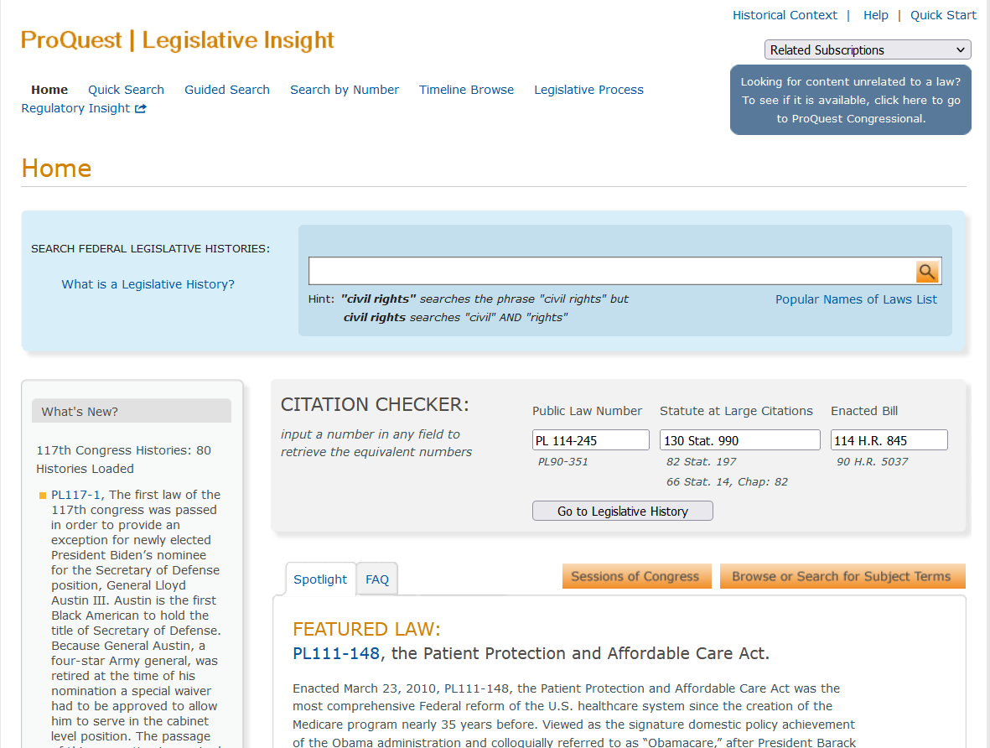
ProQuest Legislative Insight - Homepage
To search for a pre-compiled legislative history, simply enter a keyword into the search box at the top of the screen or use the “Search by Number” feature linked at the top
Legislative Insight includes a helpful “Citation Checker” that will provide the Statutes at Large and Enacted Bill citations that correspond to each Public Law Number, and vice versa

Slide 35
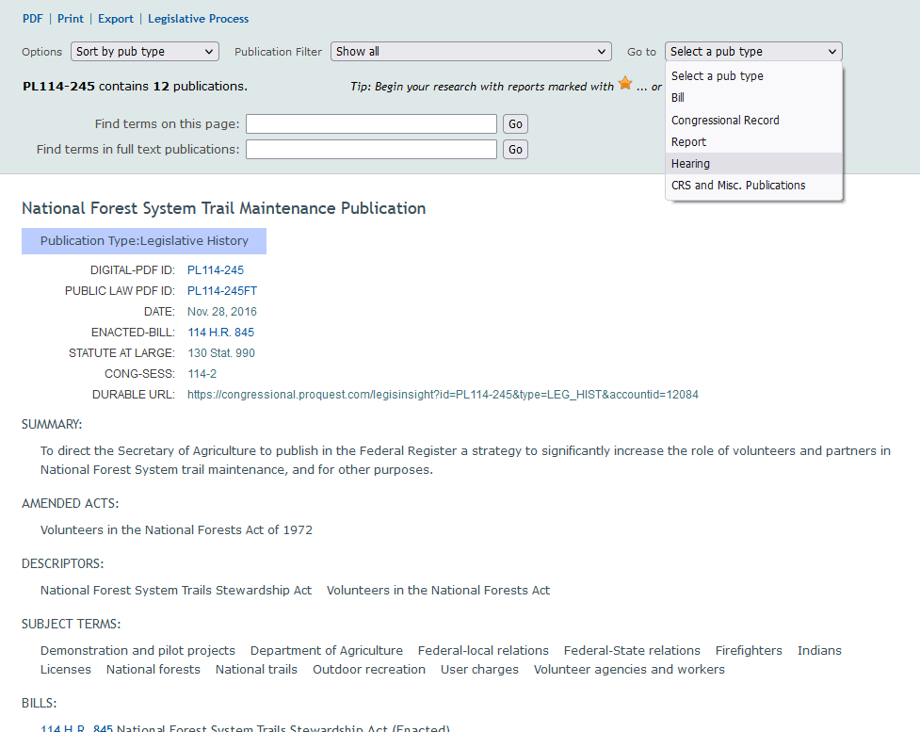
ProQuest Legislative Insight – Legislative History
Pull-down options menus allow you to organize documents by publication type and by date
Can use this search feature to search the full text of the documents listed for certain keywords

Slide 36
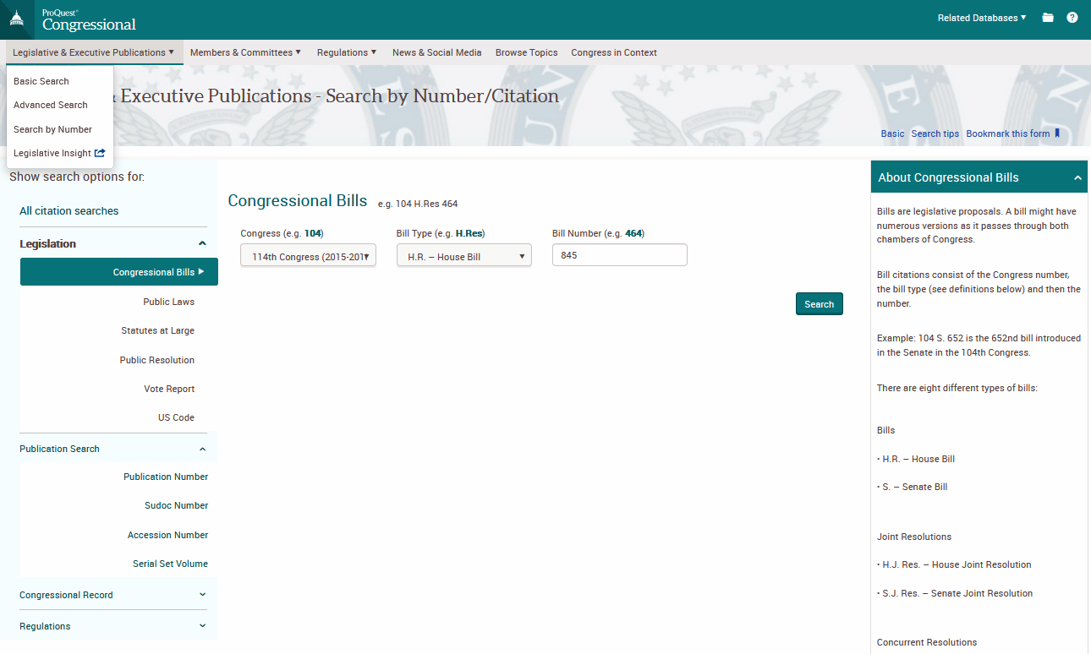
ProQuest Congressional – Number Search
If you have citation information for the bill in which you are interested, or of a report or hearing you would like, you will want to try “Search By Number,” under the “Legislative & Executive Publications” menu.
Enter the Congress number, bill type, and bill number into the fields available, and click “Search”

Slide 37
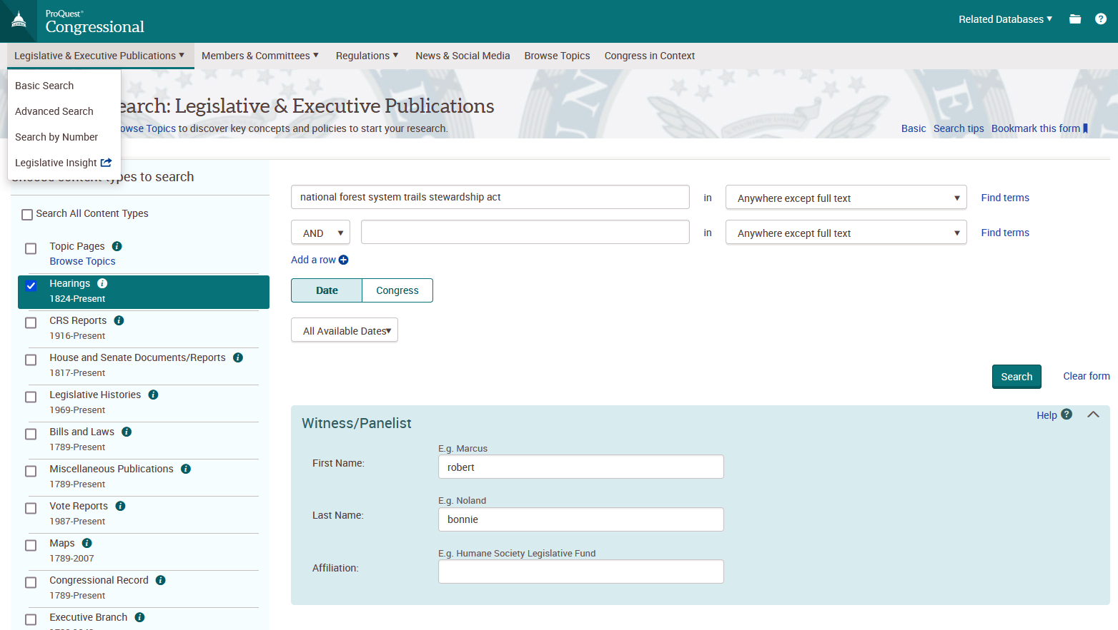
ProQuest Congressional – Advanced Search
ProQuest Congressional also has an “Advanced Search,” which allows for a keyword search, limited by date or Congress
If “Hearings” is selected as one of your content types, you can also search by witness/panelist name and affiliation

Slide 38
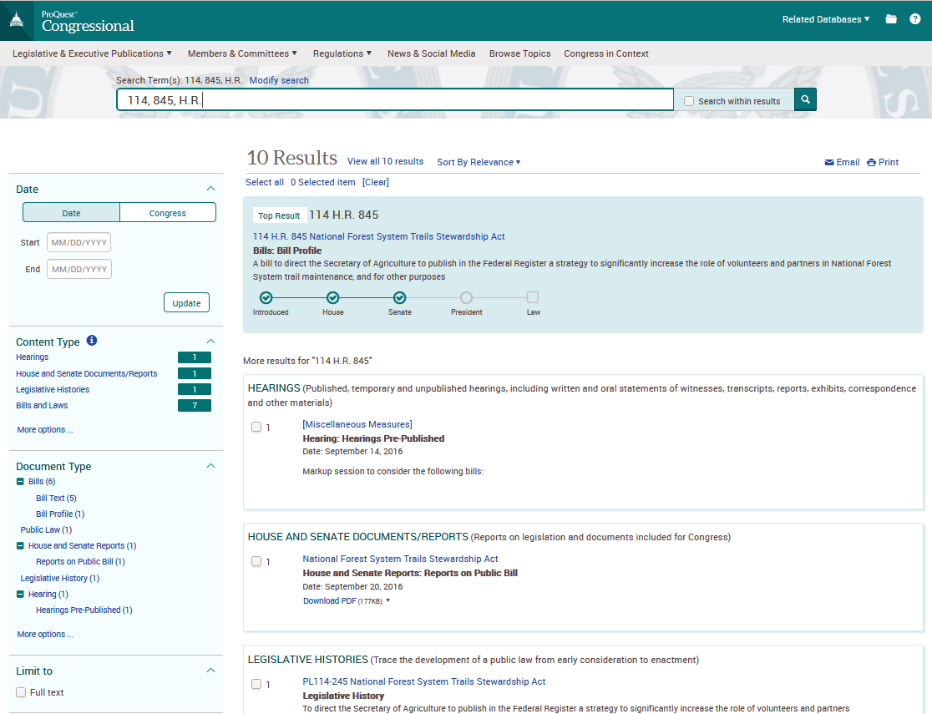
ProQuest Congressional - Results
You can limit your results by date/ Congress, type of document, committee, and subject.
Click the title of a document to find out more information and find a link to a PDF and/or text copy of the document

Slide 39
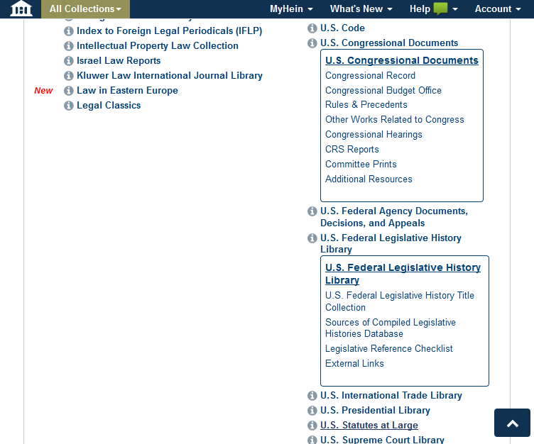
HeinOnline - U.S. Federal Legislative History and Congressional Documents Collections
Pre-compiled legislative histories can be found under the U.S. Federal Legislative History Library Collection
The U.S. Congressional Documents Collection contains the debates of Congress (Congressional Record, Congressional Globe, Register of Debates, Annals of Congress), Selected Congressional Hearings, CRS Reports, and other helpful documents

Slide 40
Legislative History Guides
Law Library of Congress, “Compiling a Federal Legislative History: A Beginner’s Guide”
Includes detailed instructions for tracing legislation, locating pre-compiled legislative history reports, and finding different types of legislative history documents
Pages of particular interest:
Published Congressional Hearings - https://guides.loc.gov/legislative-history/published-congressional-hearings
Unpublished Congressional Hearings - https://guides.loc.gov/legislative-history/unpublished-congressional-hearings
Law Librarians’ Society of Washington, DC (LLSDC), “Federal Legislative History Research: A Practitioner’s Guide to Compiling the Documents and Sifting for Legislative Intent”
https://www.llsdc.org/federal-legislative-history-guide
Georgetown University Law Library, “Legislative History Research Guide”
https://guides.ll.georgetown.edu/legislative_history

Slide 41
Questions? Contact Us! Ask a Librarian: https://ask.loc.gov/law/

