Slide 1
2015 DLC Meeting and FDLP Conference
October 19-21, 2015 Arlington, Virginia

Slide 2
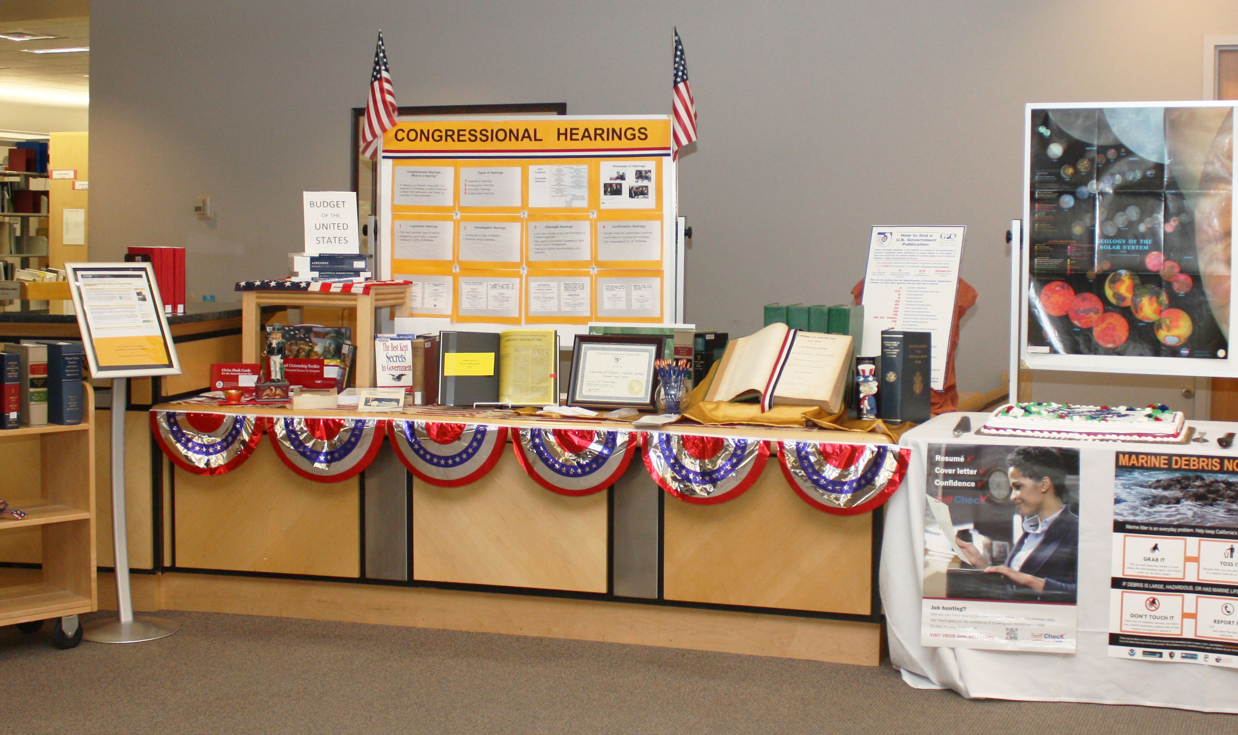
Reception and display celebrating our 40th anniversary as a depository Library, July 3, 2014. Kraemer Family Library, University of Colorado - Colorado Springs.

Slide 3
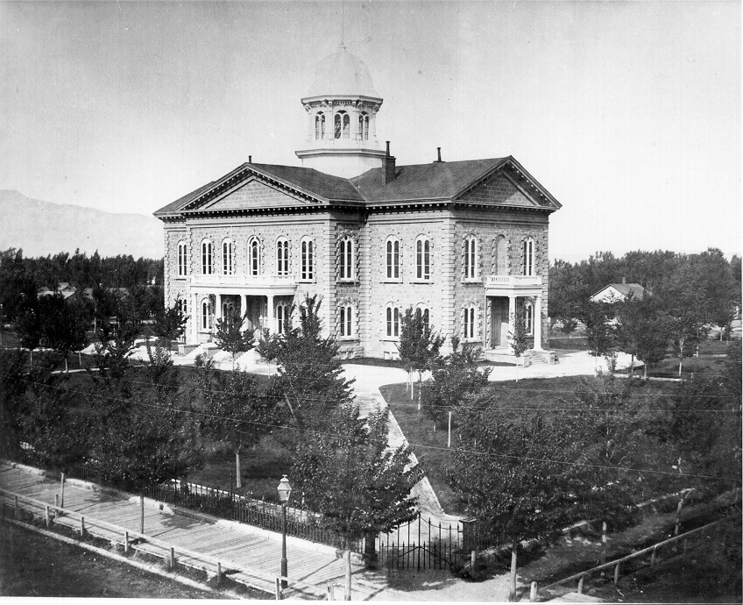
The Nevada State Library was housed in the Capitol Building from 1871-1909.

Slide 4
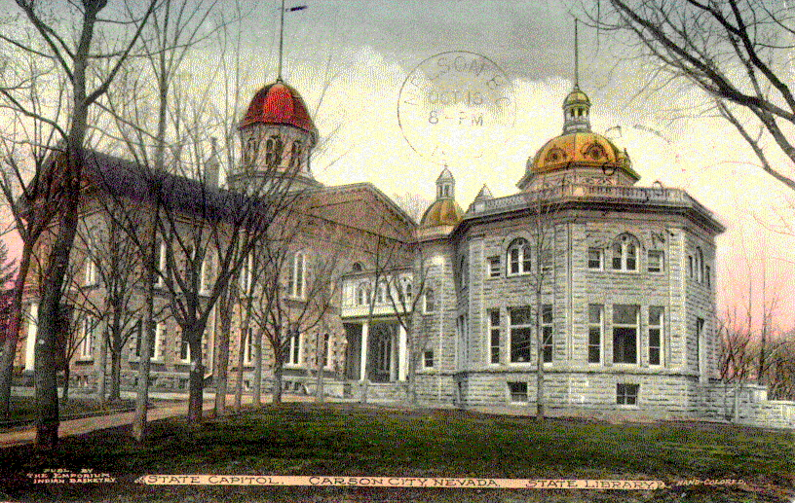
The Capitol Annex housed the Nevada State Library from 1909 through 1937.

Slide 5
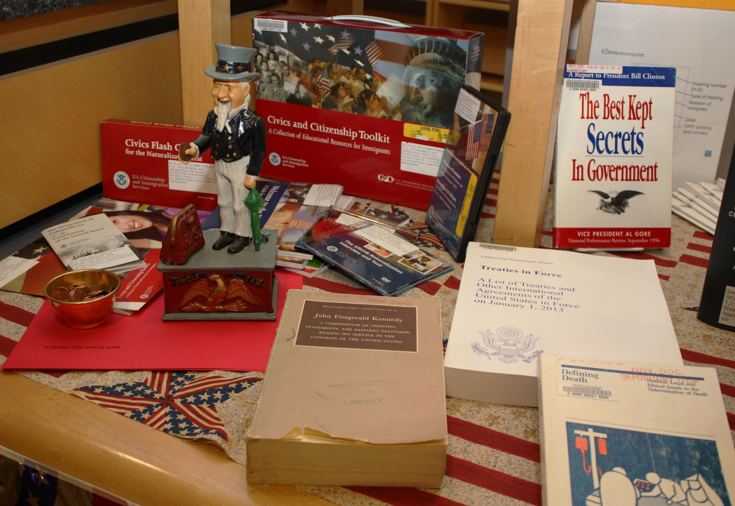
Reception and display celebrating our 40th anniversary as a depository Library, July 3, 2014. Kraemer Family Library, University of Colorado - Colorado Springs.

Slide 6
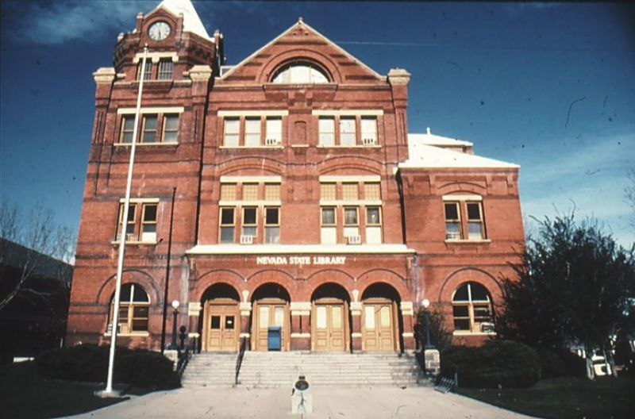
The Laxalt Building housed the Nevada State Library from 1972 to 1993.

Slide 7
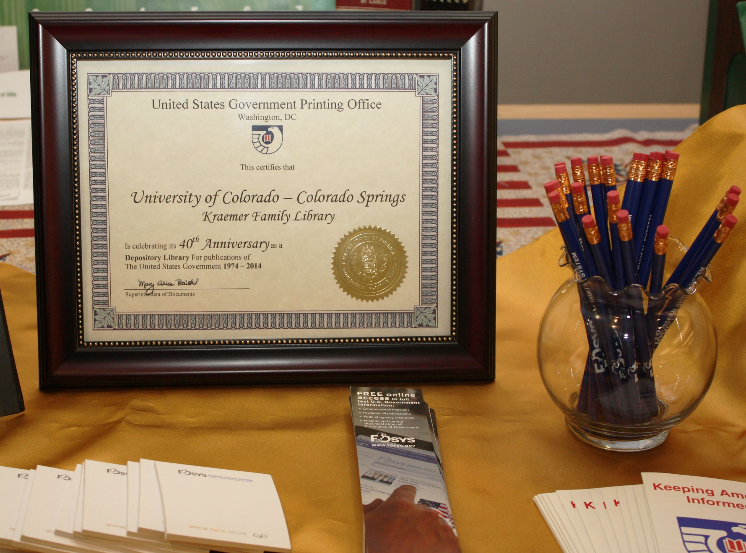
Reception and display celebrating our 40th anniversary as a depository Library, July 3, 2014. Kraemer Family Library, University of Colorado - Colorado Springs.

Slide 8
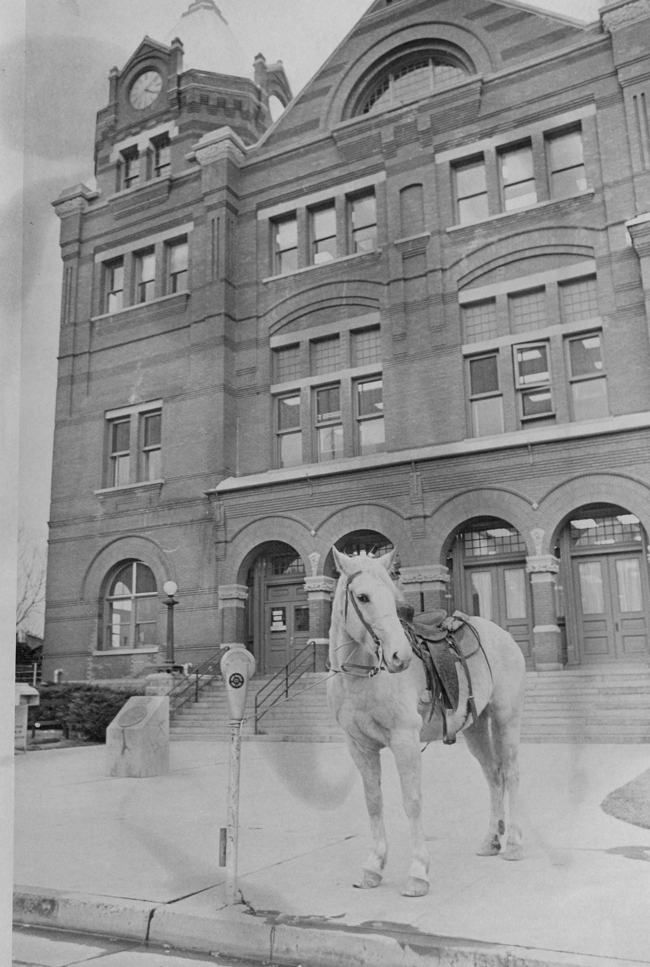
The Laxalt Building housed the Nevada State Library from 1972 to 1993.

Slide 9
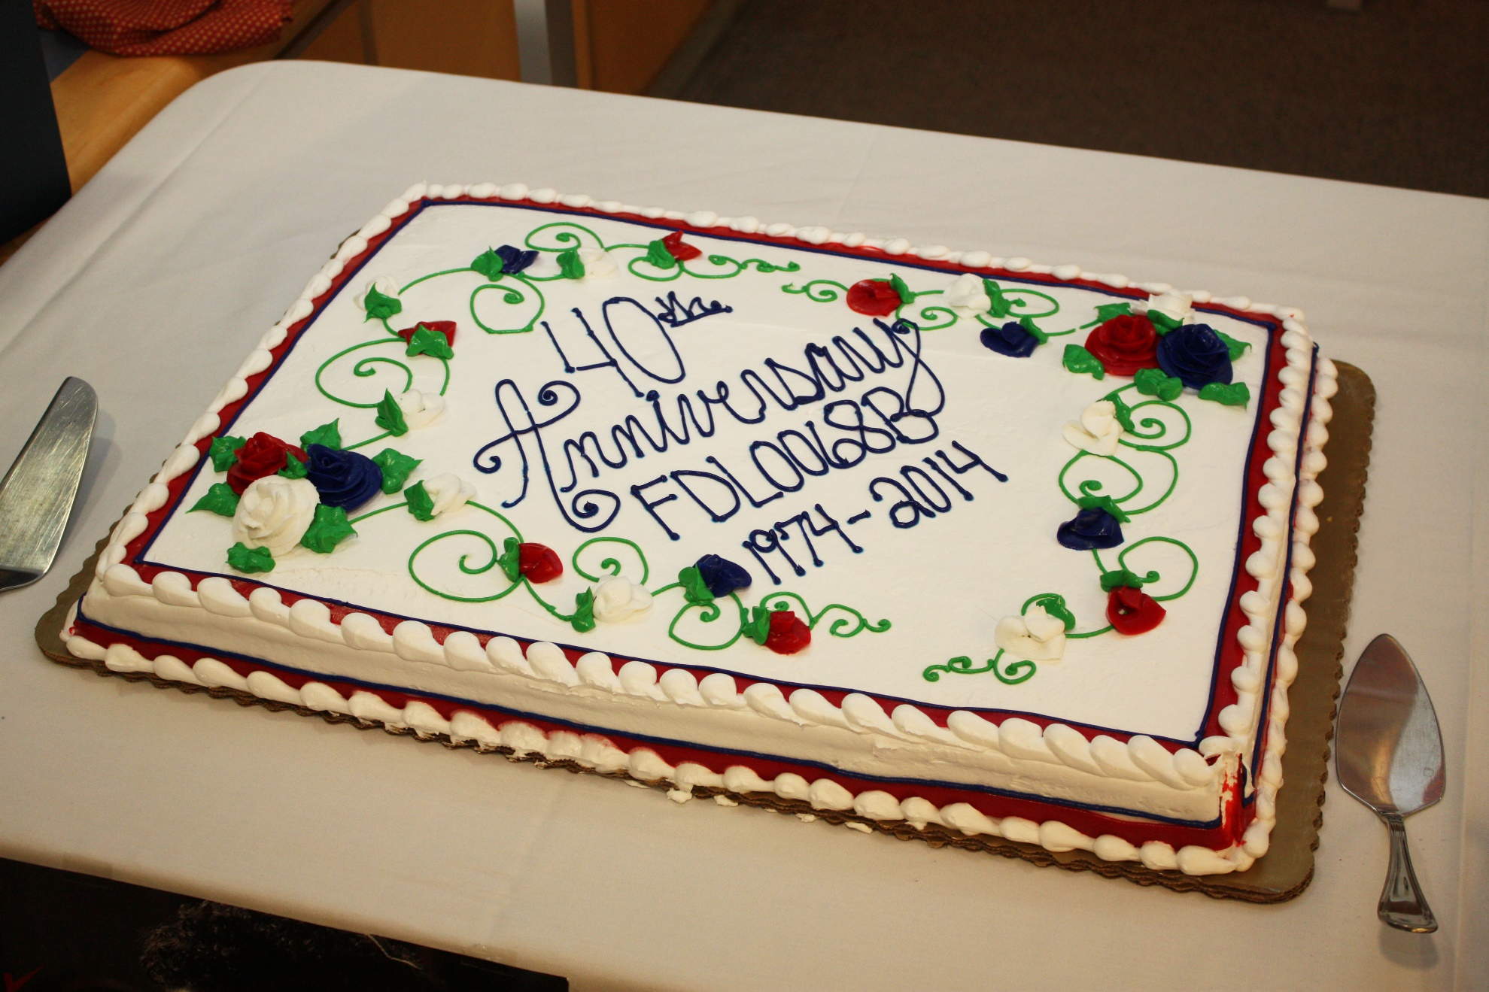
Reception and display celebrating our 40th anniversary as a depository Library, July 3, 2014. Kraemer Family Library, University of Colorado - Colorado Springs.

Slide 10
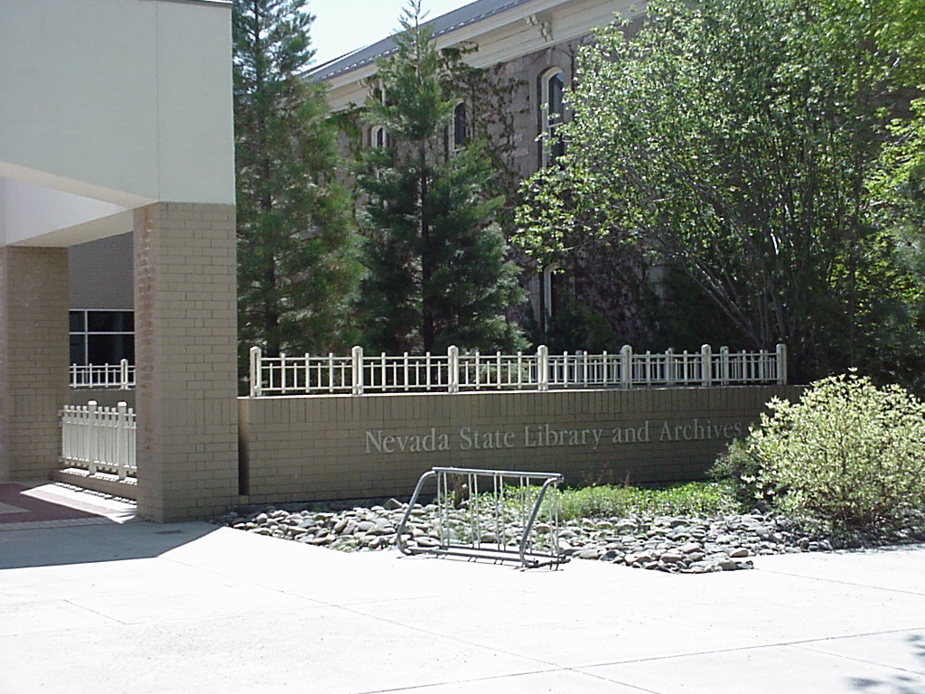
The Nevada State Library and Archives building has been our home from 1993 to present. This was the first building designed specifically for the State Library and Archives.

Slide 11
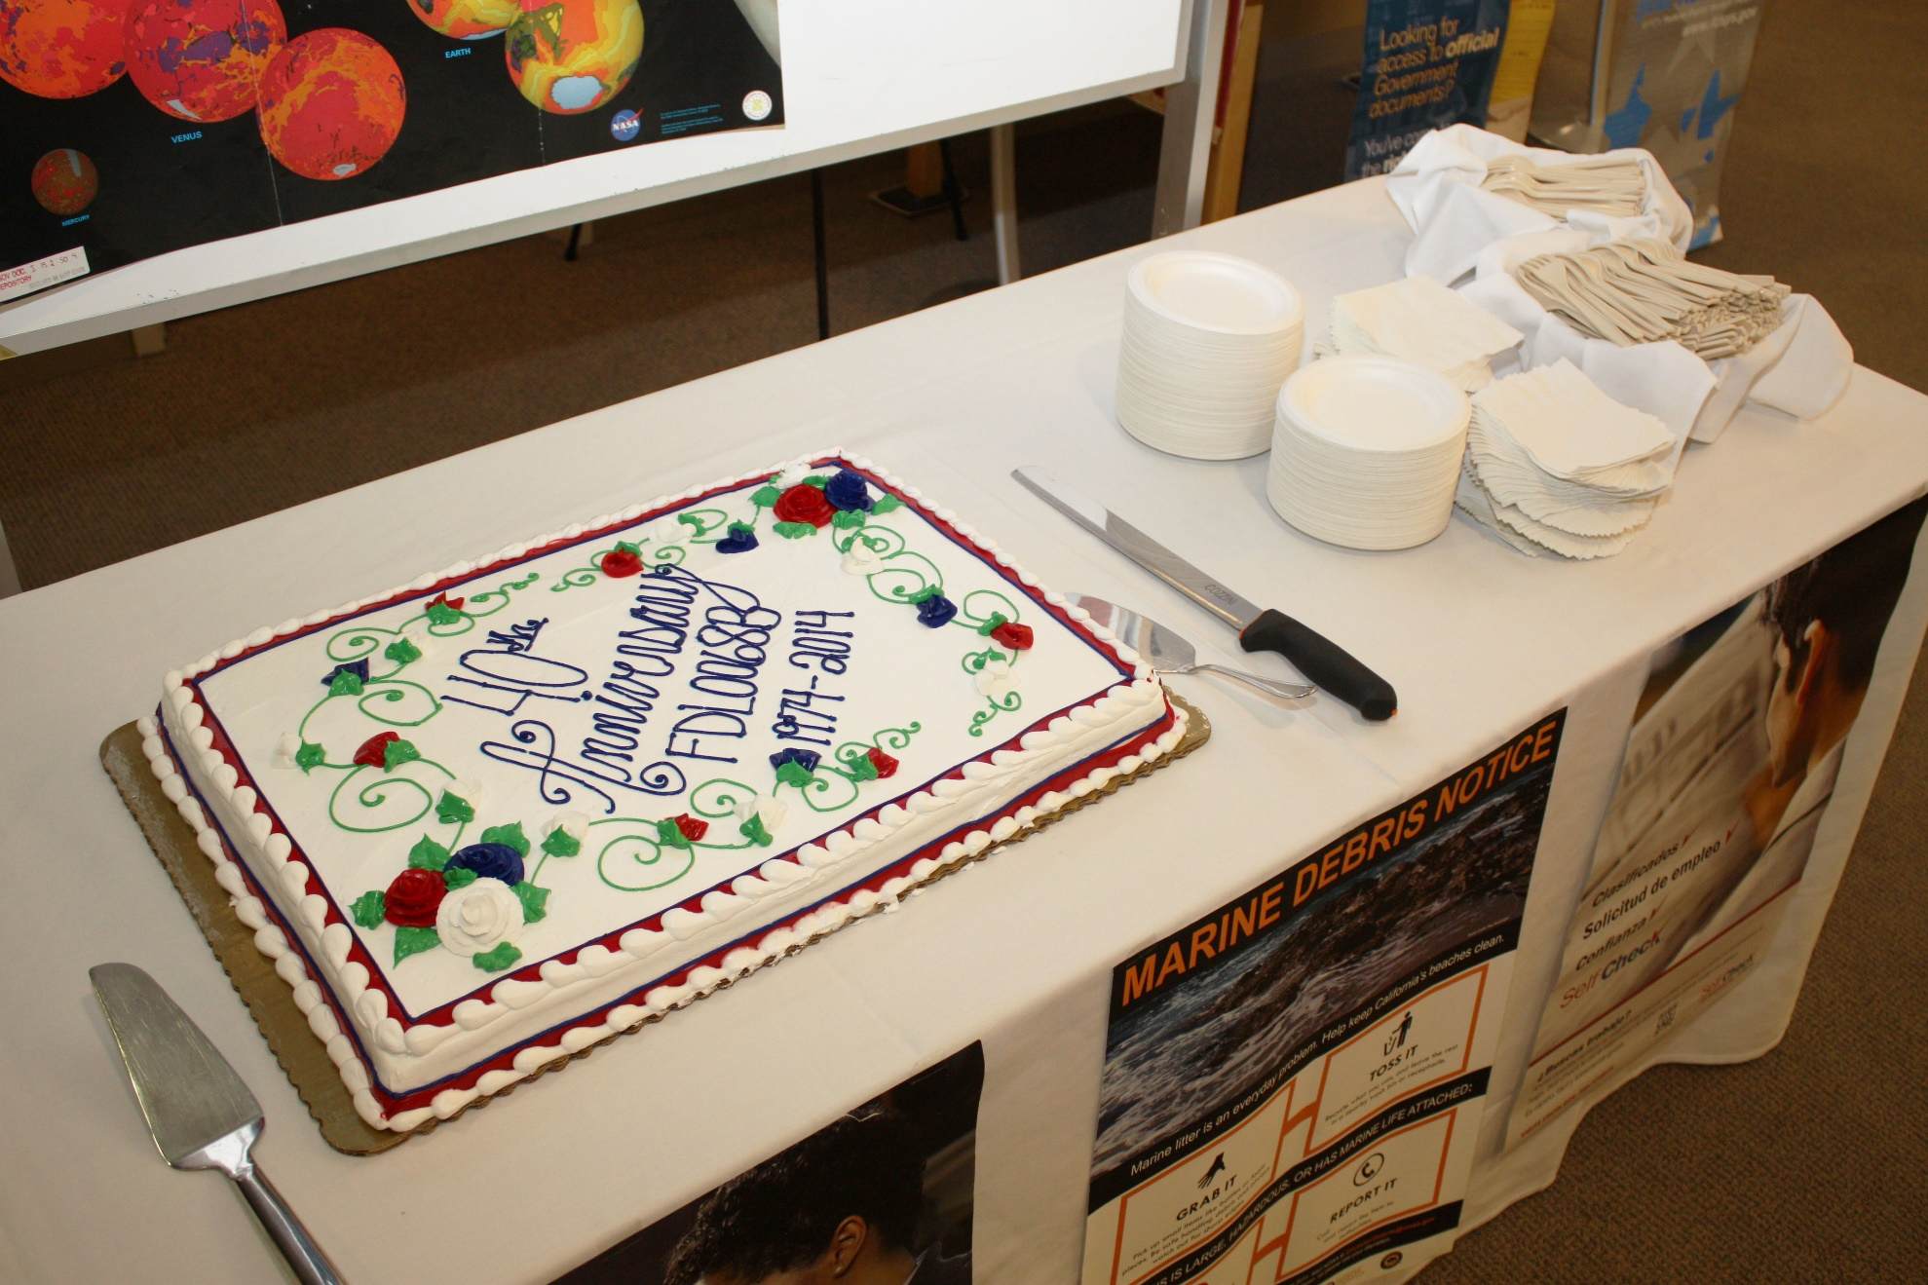
Reception and display celebrating our 40th anniversary as a depository Library, July 3, 2014. Kraemer Family Library, University of Colorado - Colorado Springs.

Slide 12
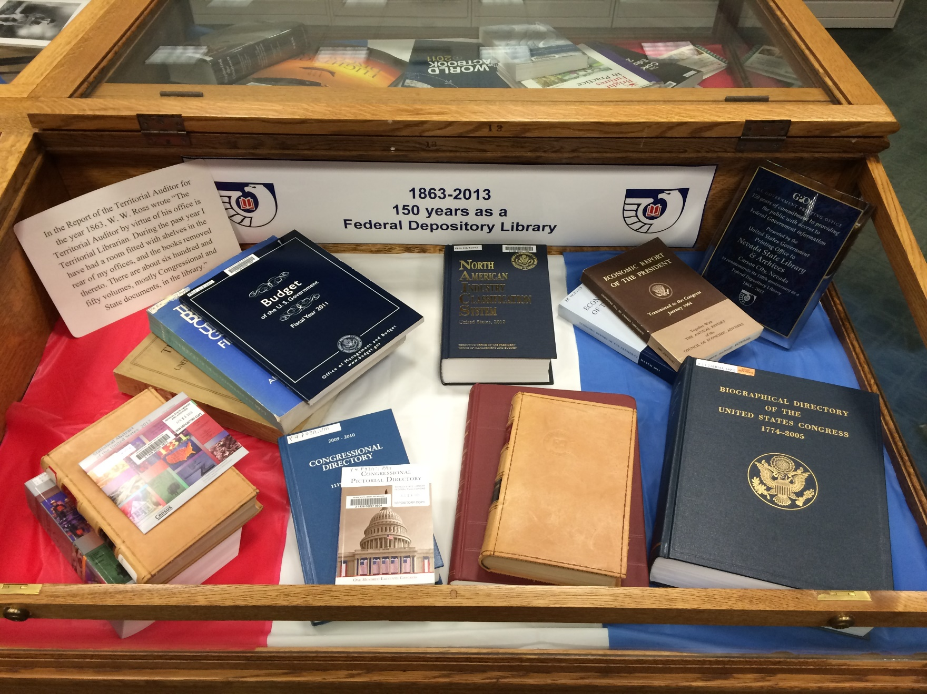
Display for sesquicentennial anniversary of the Nevada State Library as a Federal depository.

Slide 13
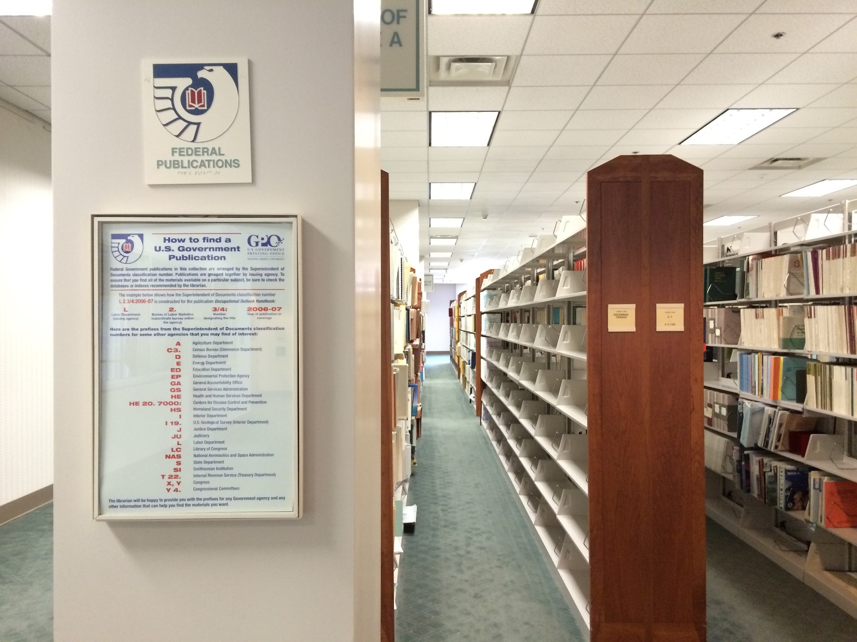
Current depository collection housed on the top floor of the Nevada State Library, Archives and Public Records.

Slide 14
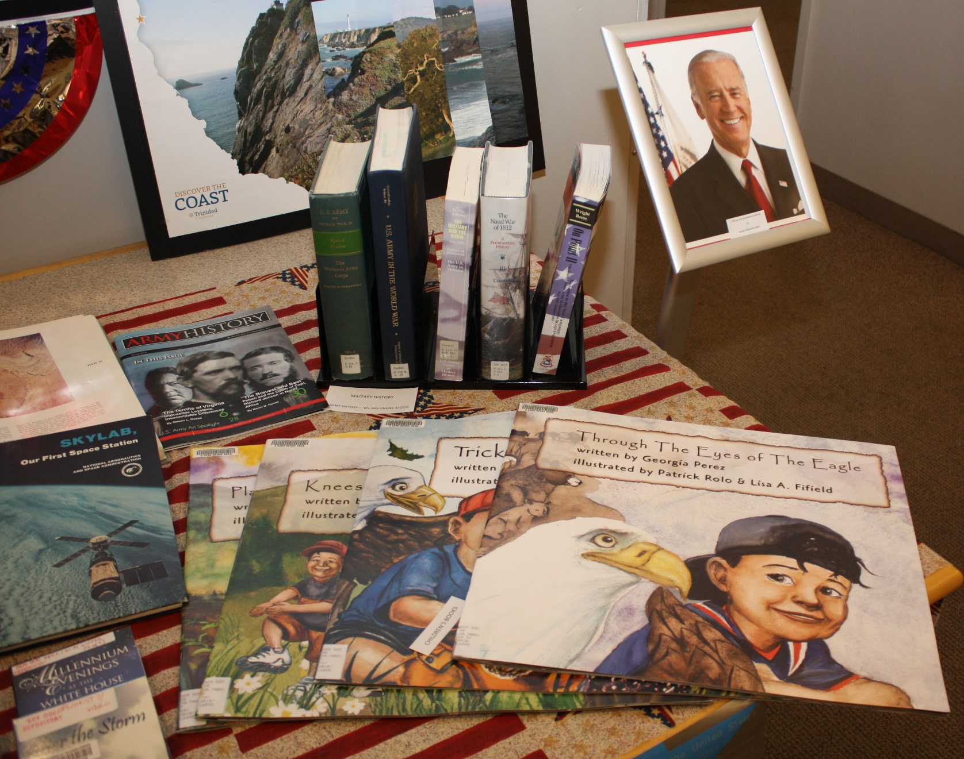
Reception and display celebrating our 40th anniversary as a depository Library, July 3, 2014. Kraemer Family Library, University of Colorado - Colorado Springs.

Slide 15
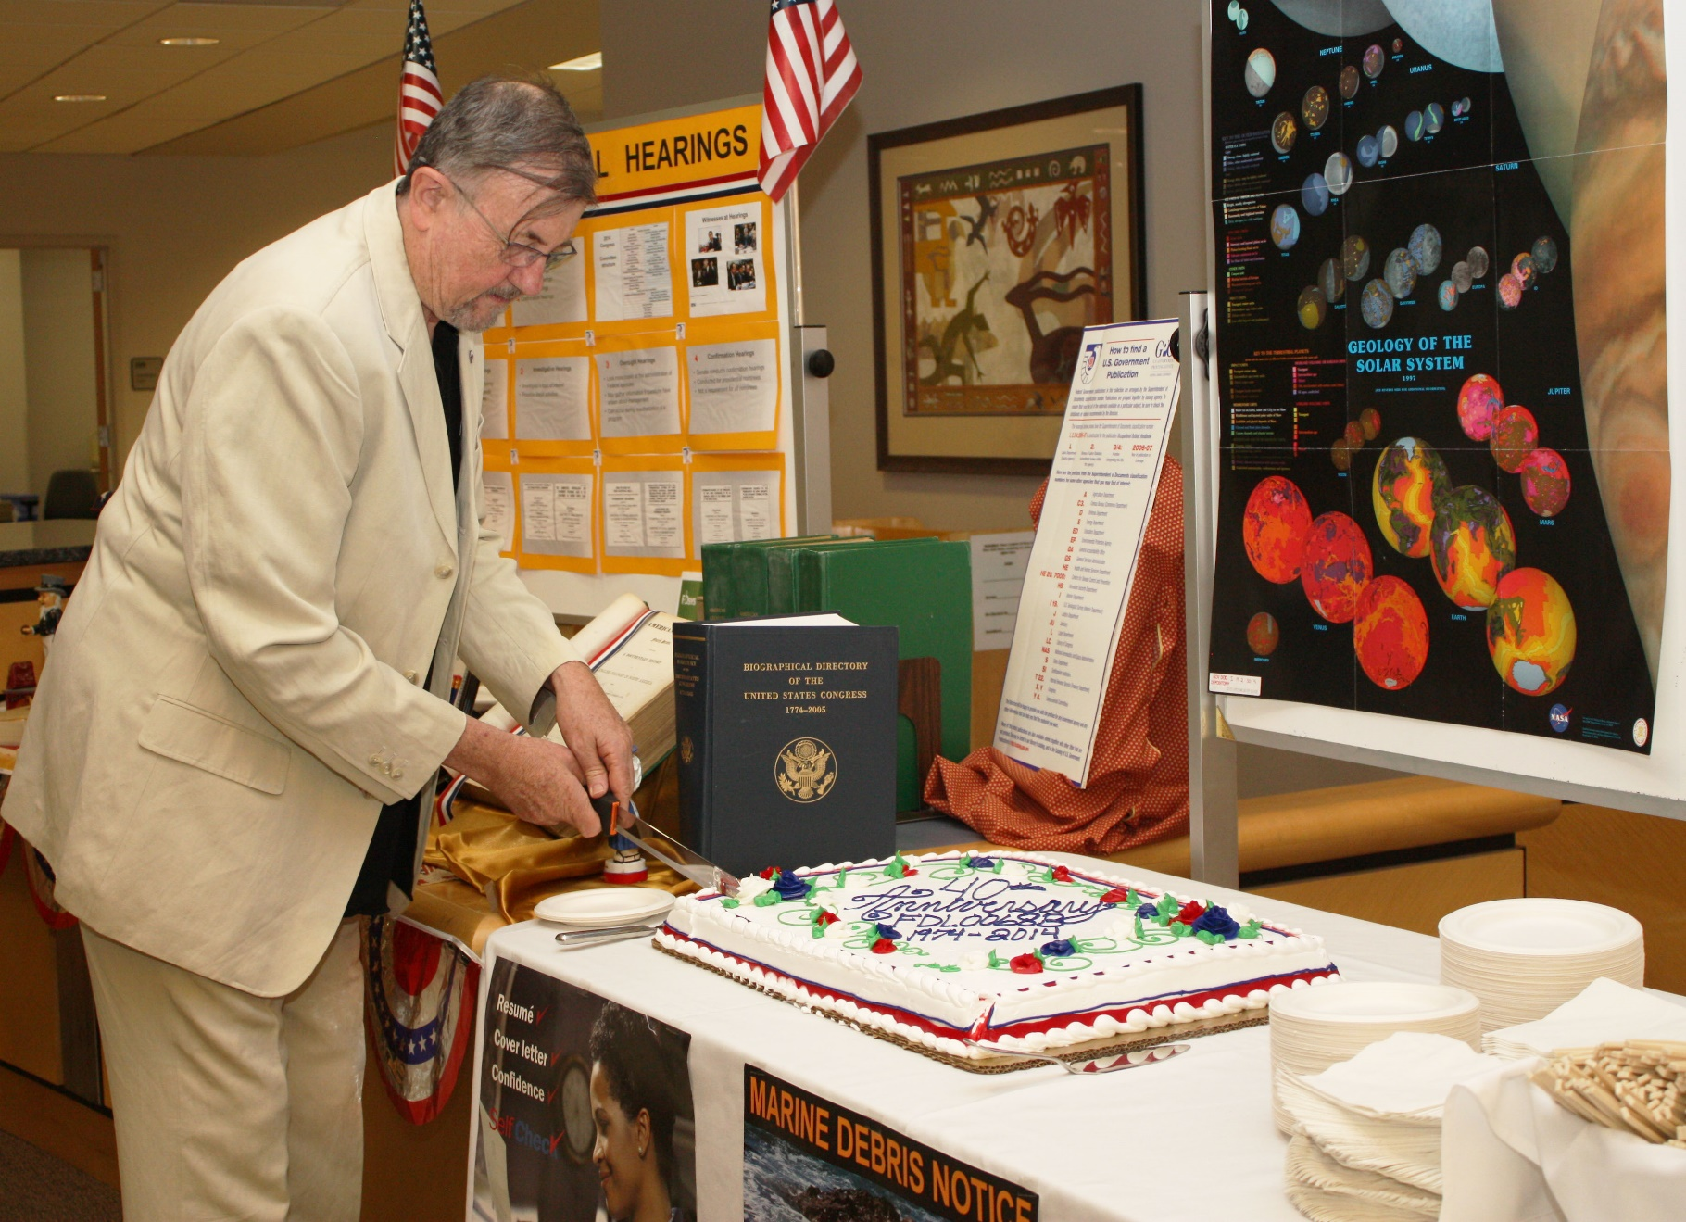
Reception and display celebrating our 40th anniversary as a depository Library, July 3, 2014. Kraemer Family Library, University of Colorado - Colorado Springs.

Slide 16
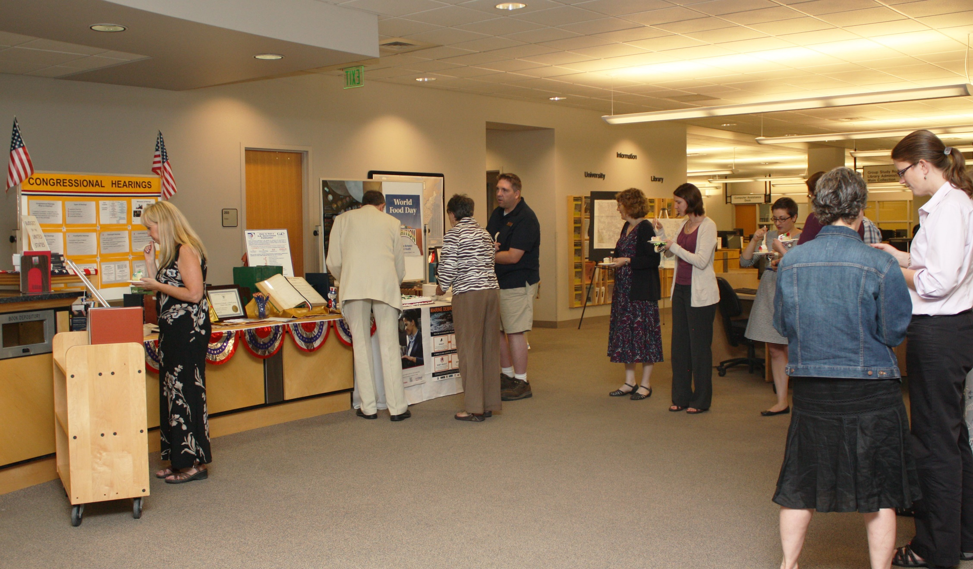
Reception and display celebrating our 40th anniversary as a depository Library, July 3, 2014. Kraemer Family Library, University of Colorado - Colorado Springs.

Slide 17
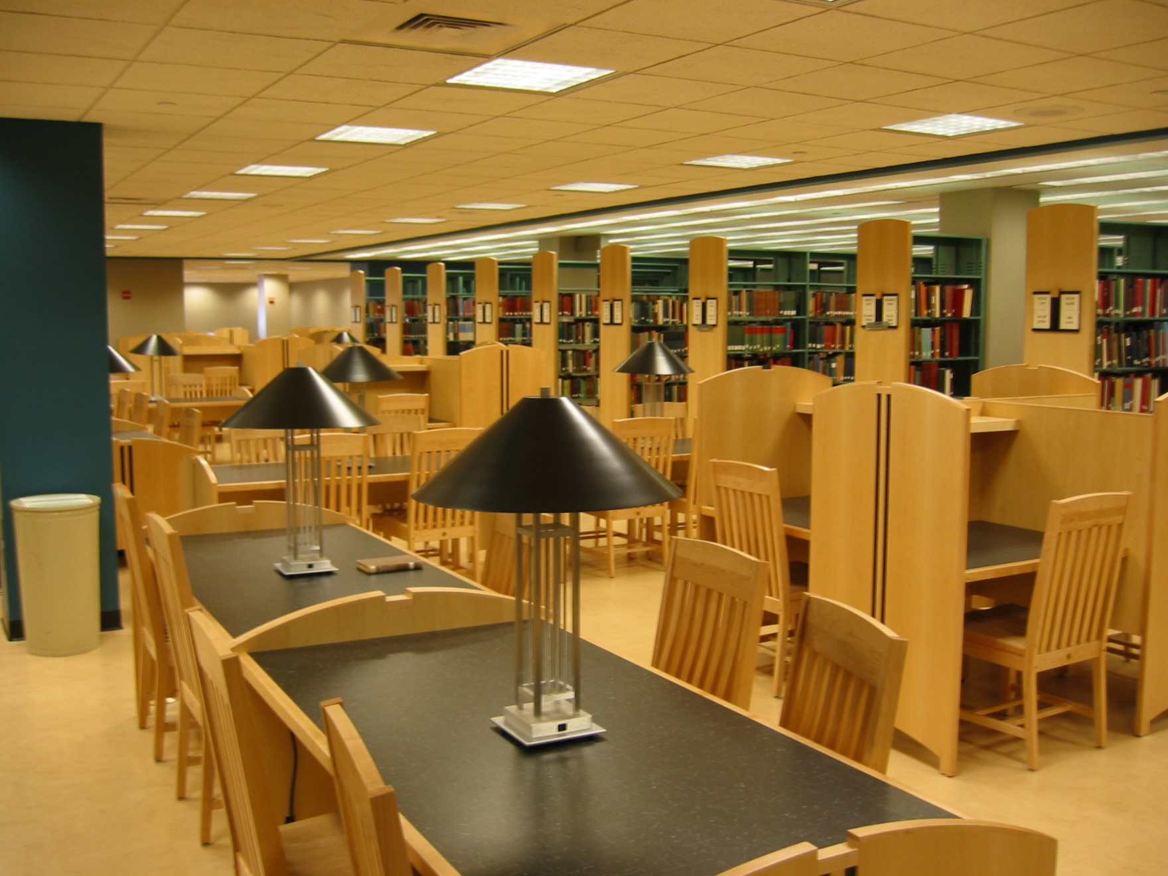
Humanities, Social Science, and Education Library - Purdue University Libraries.

Slide 18
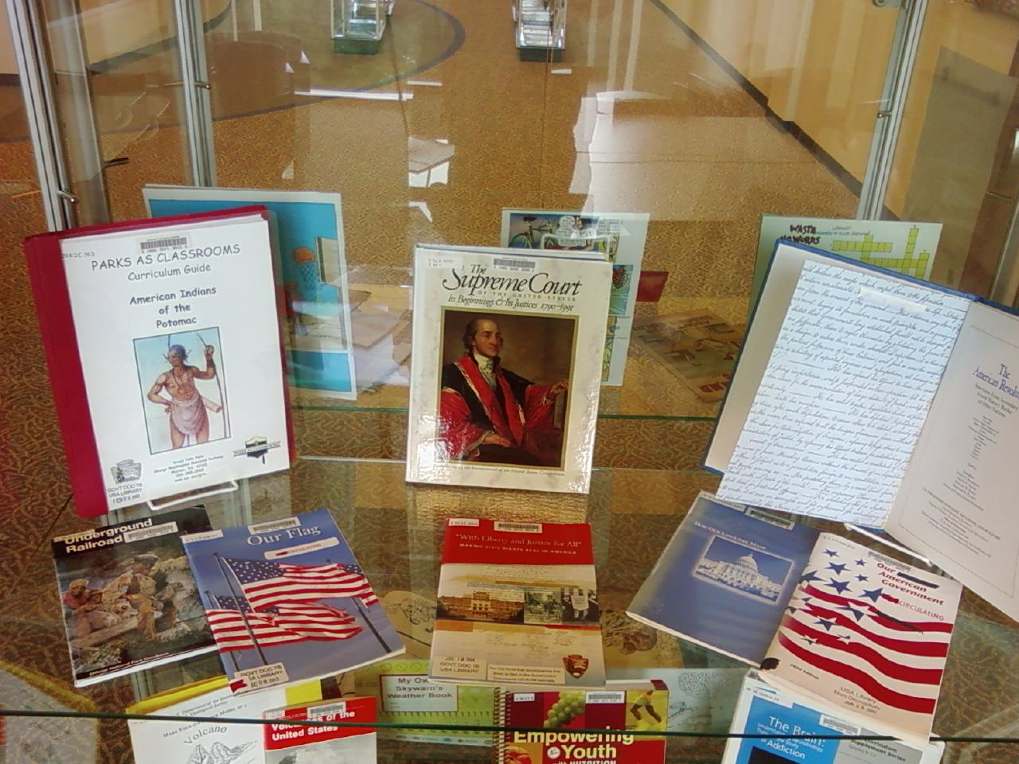
Government documents at the University of South Alabama.

Slide 19
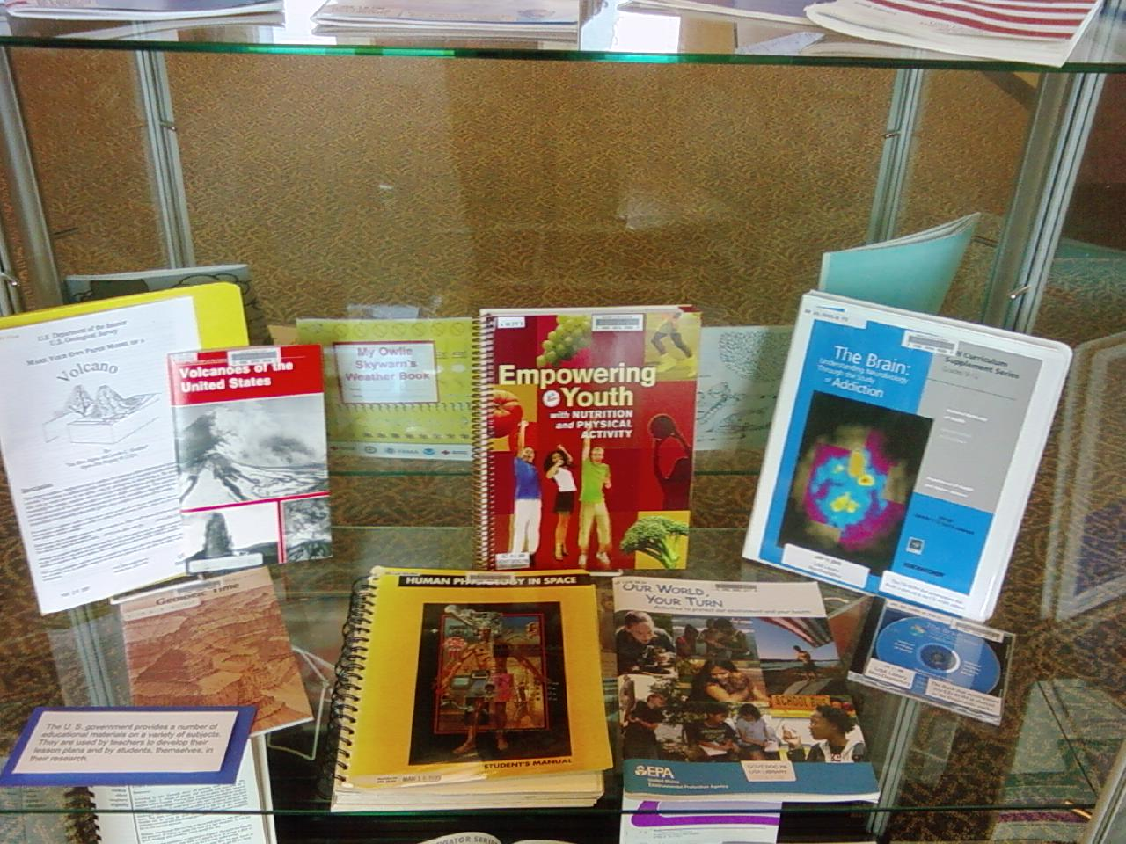
Government documents at the University of South Alabama.

Slide 20
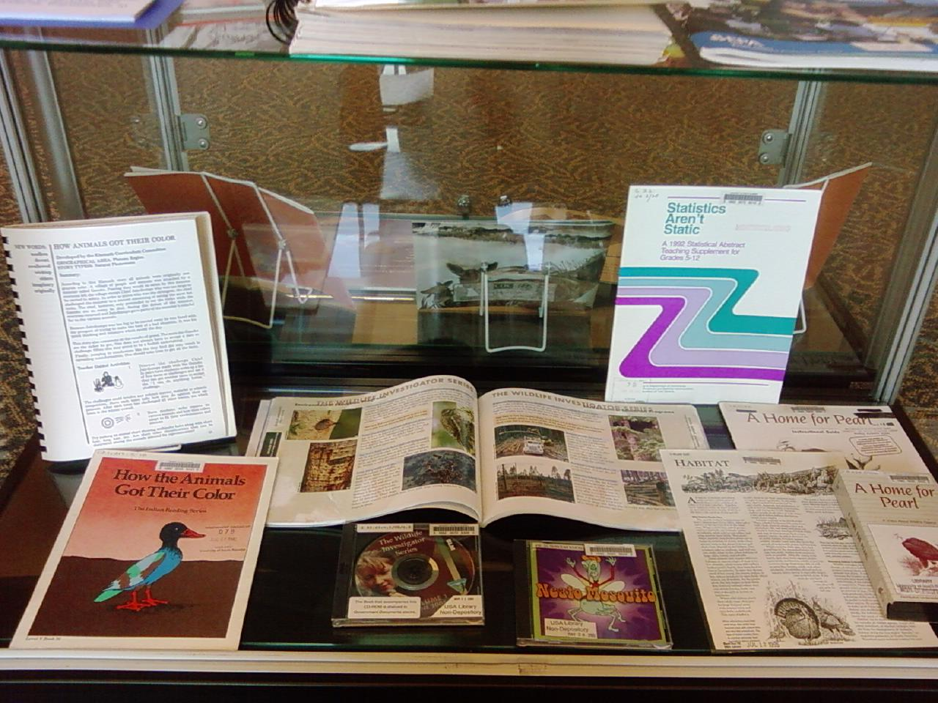
Government documents at the University of South Alabama.

Slide 21
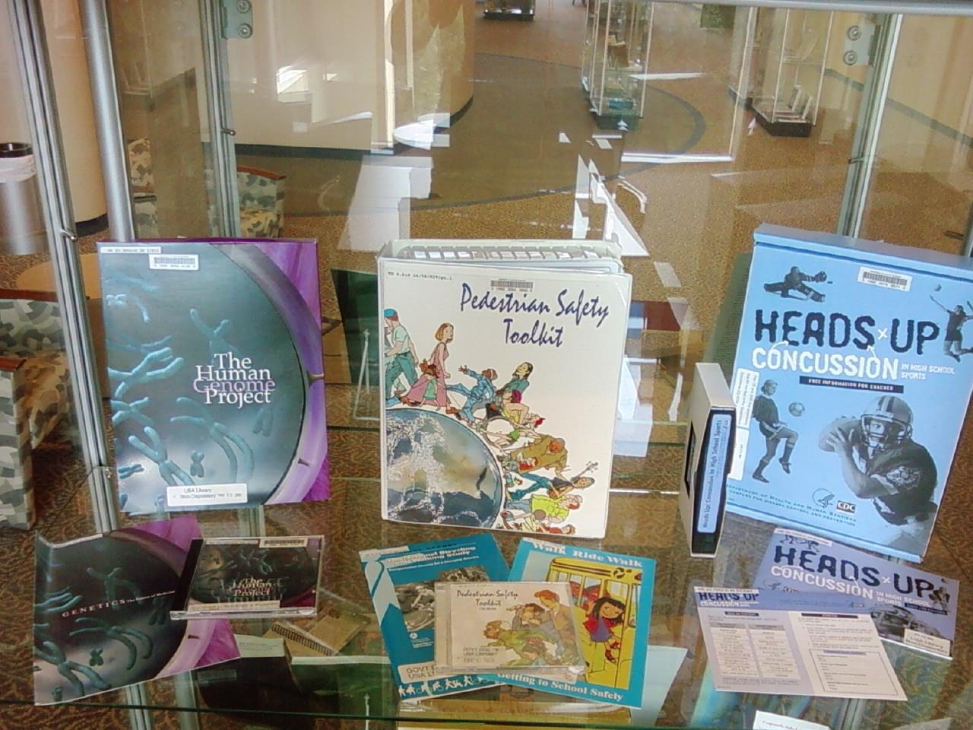
Government documents at the University of South Alabama.

Slide 22
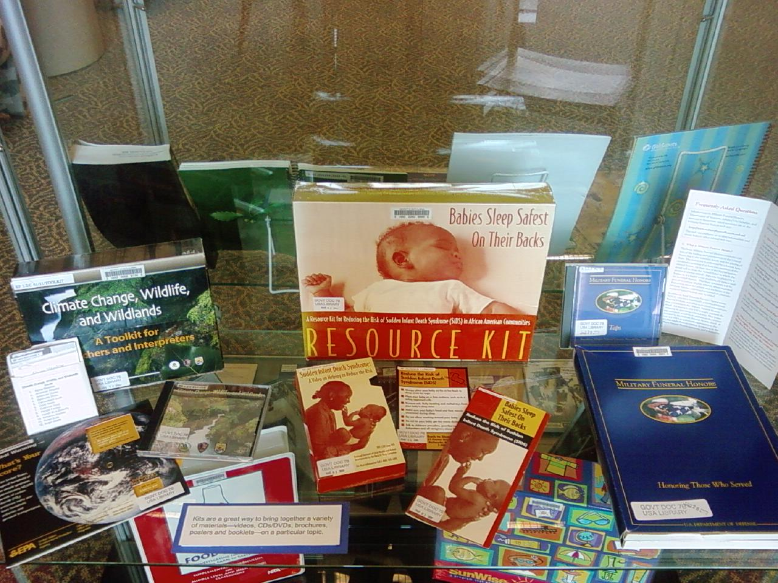
Government documents at the University of South Alabama.

Slide 23
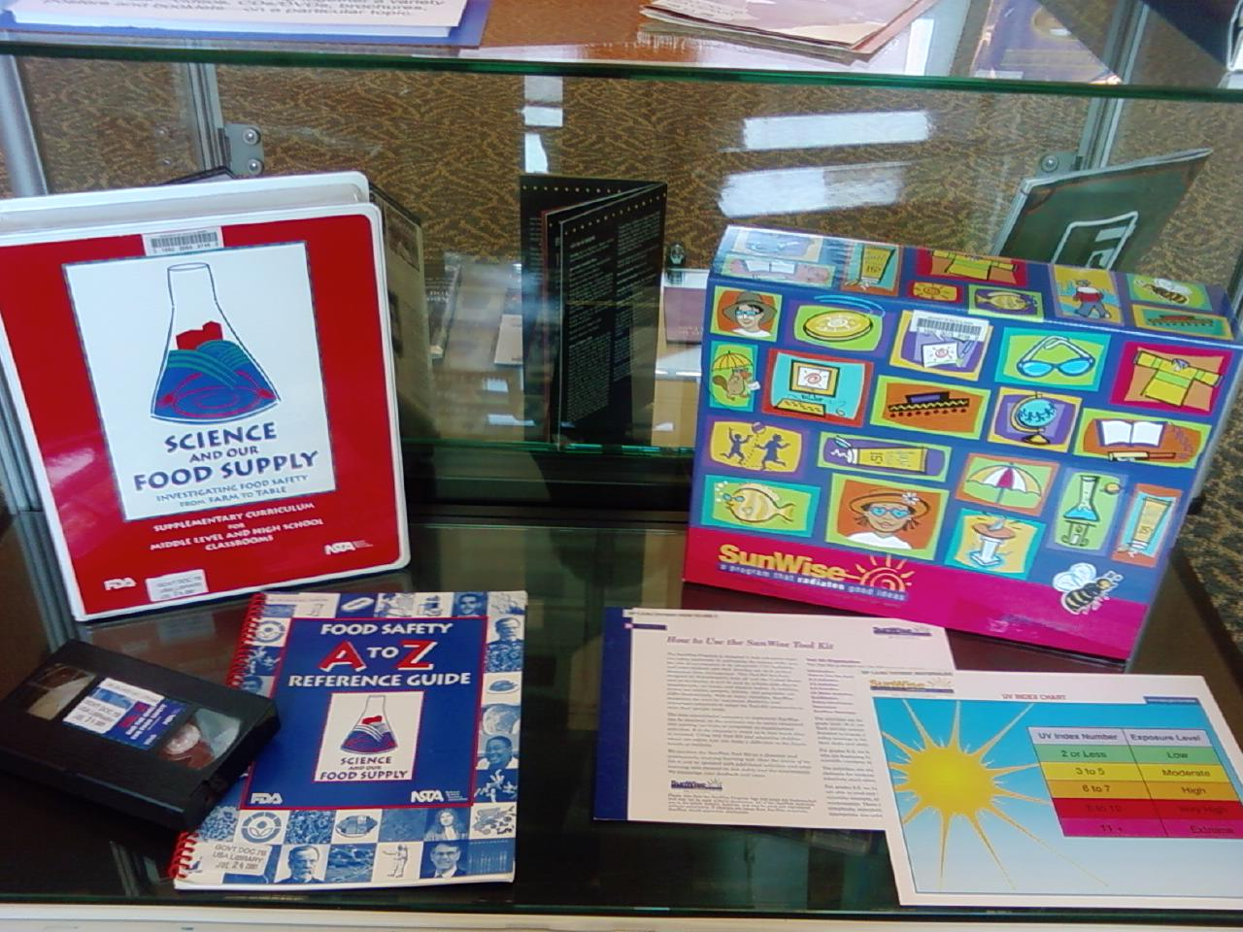
Government documents at the University of South Alabama.

Slide 24
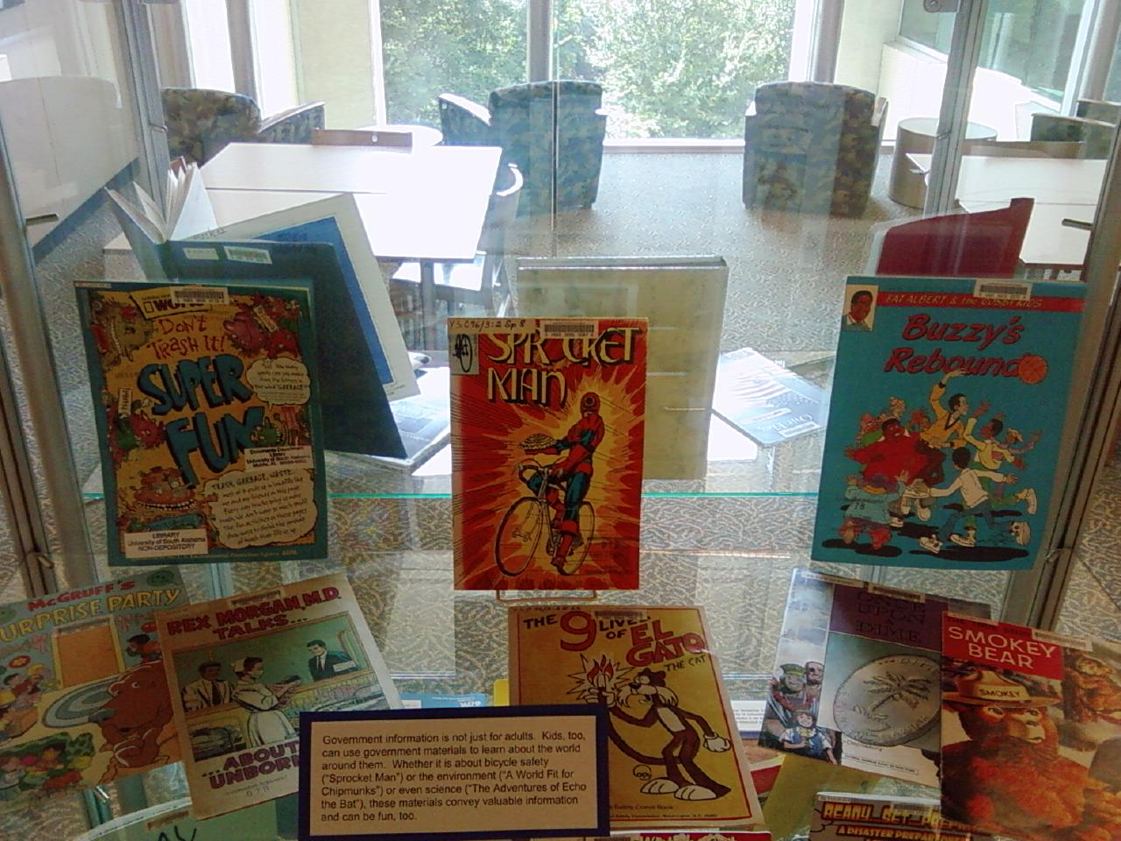
Government documents at the University of South Alabama.

Slide 25
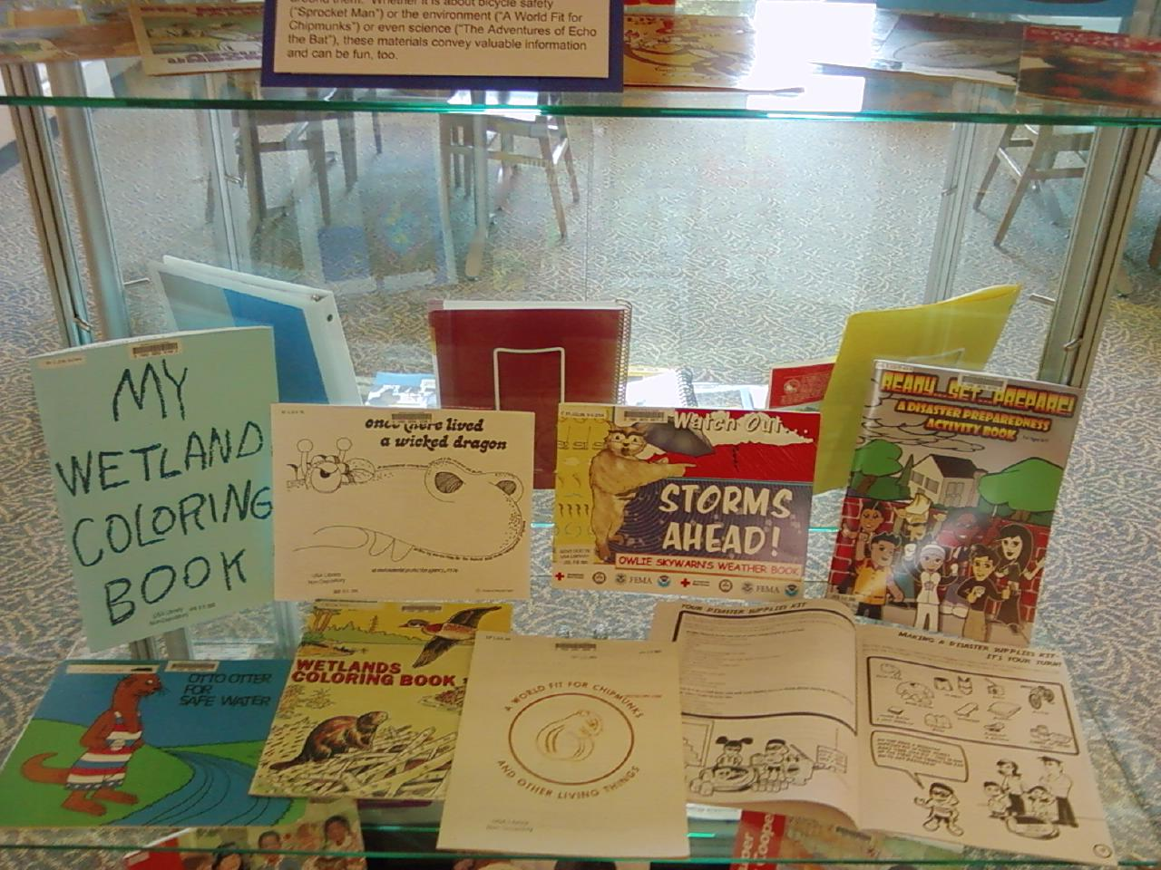
Government documents at the University of South Alabama.

Slide 26
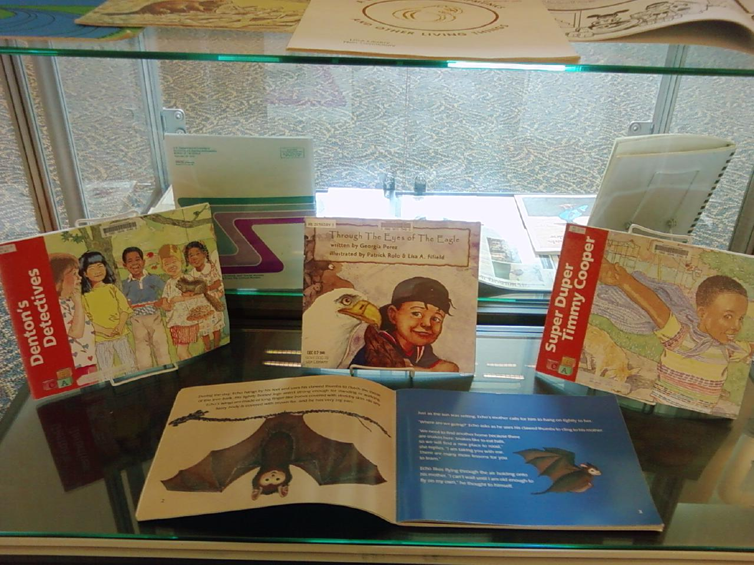
Government documents at the University of South Alabama.

Slide 27
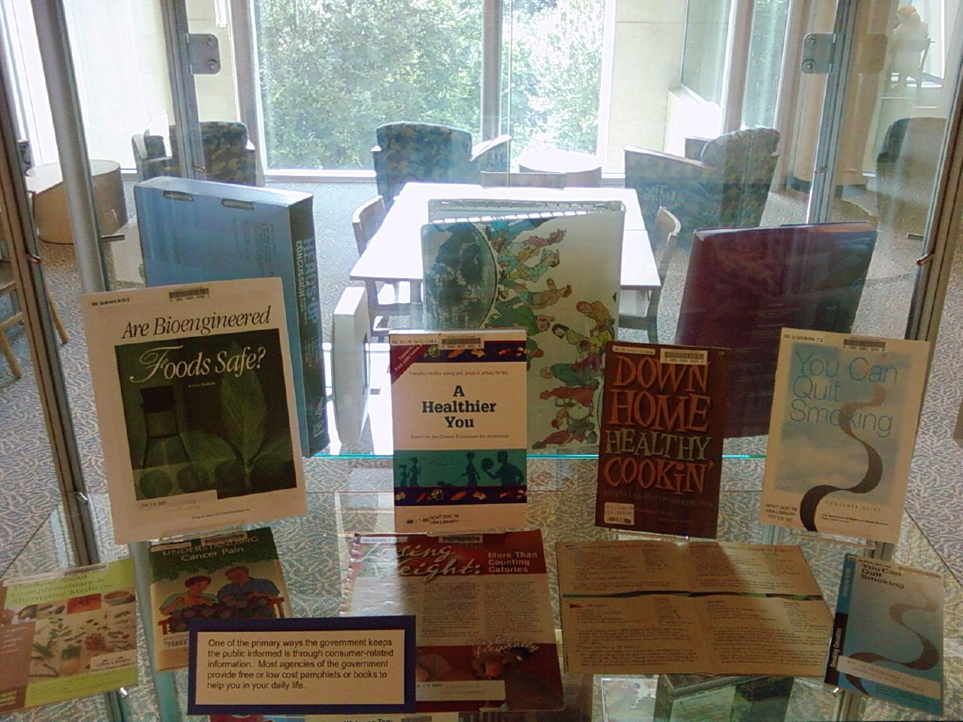
Government documents at the University of South Alabama.

Slide 28
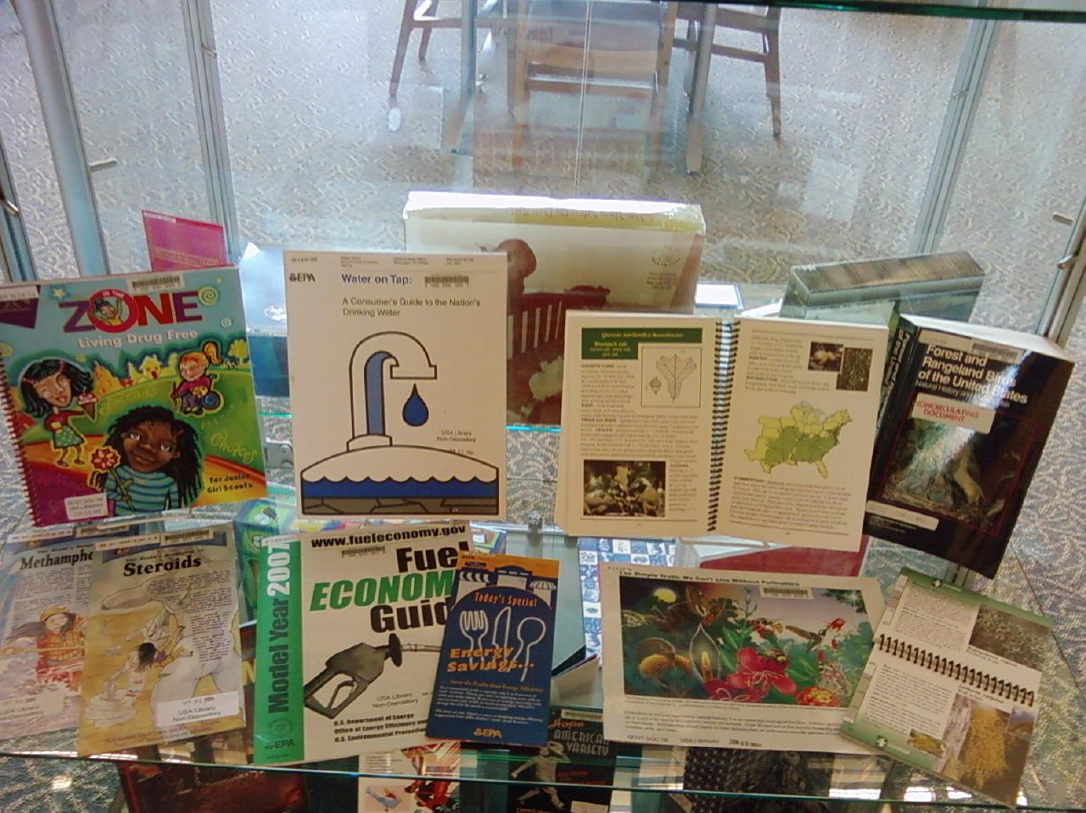
Government documents at the University of South Alabama.

Slide 29
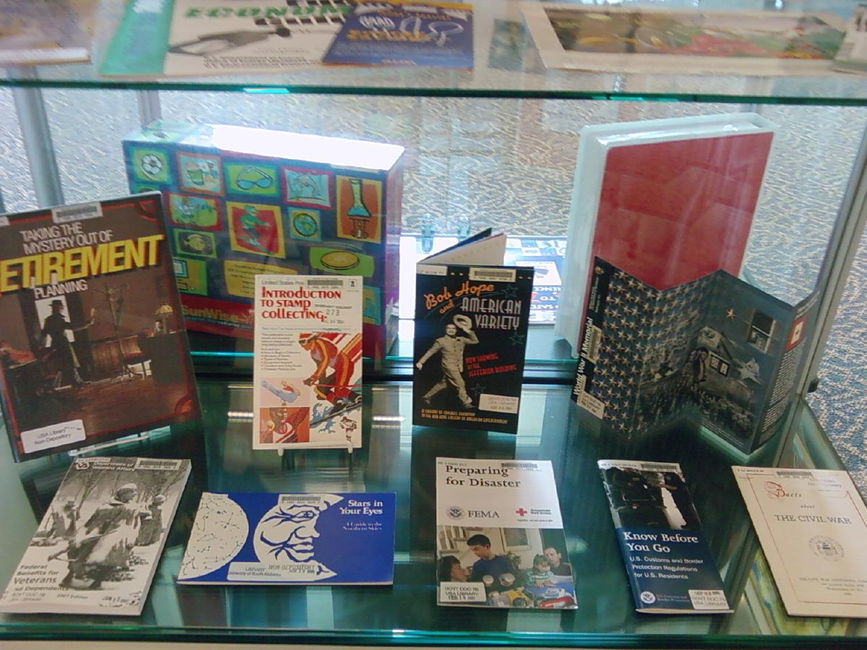
Government documents at the University of South Alabama.

Slide 30
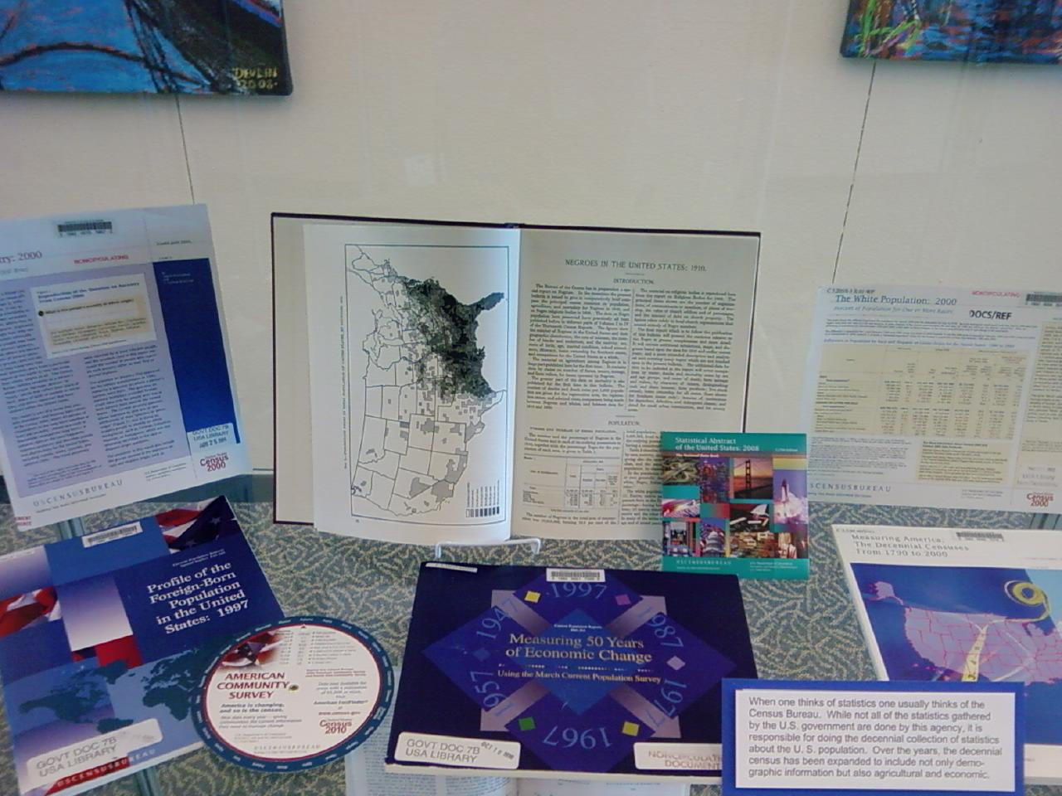
Government documents at the University of South Alabama.

Slide 31
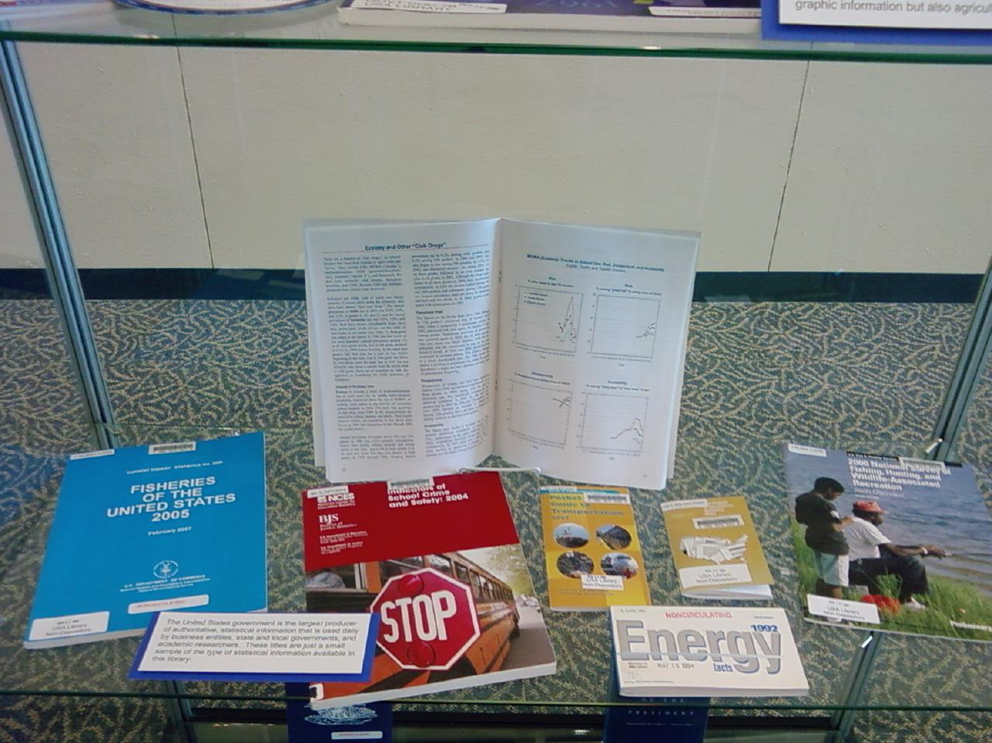
Government documents at the University of South Alabama.

Slide 32
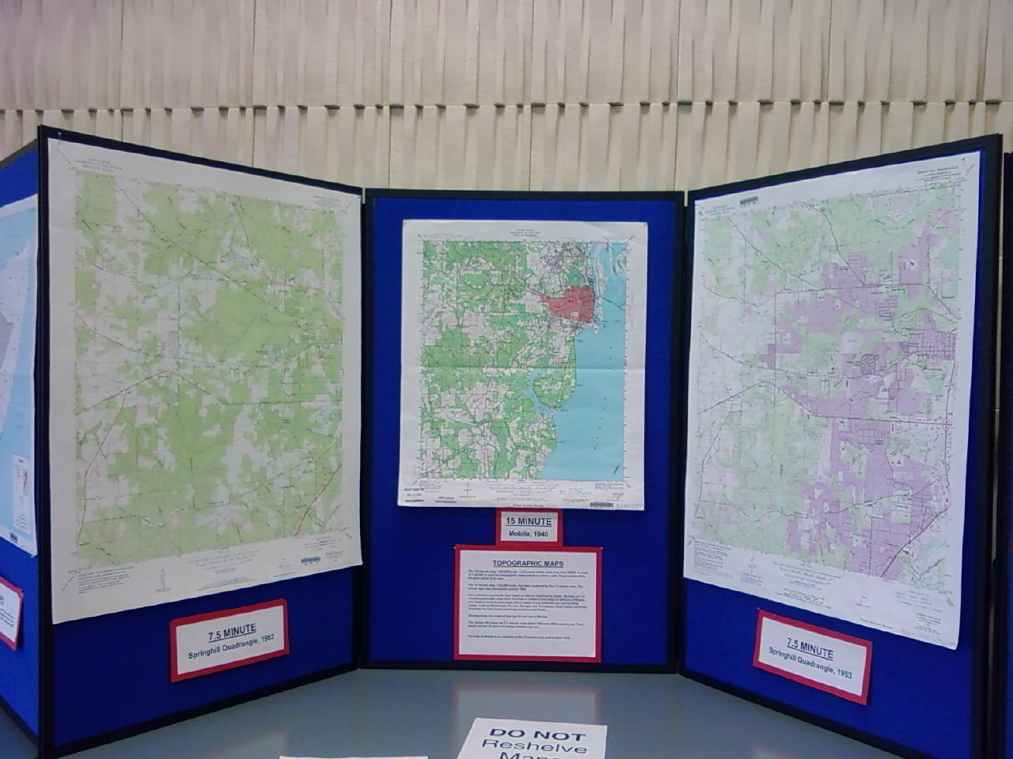
Government documents at the University of South Alabama.

Slide 33
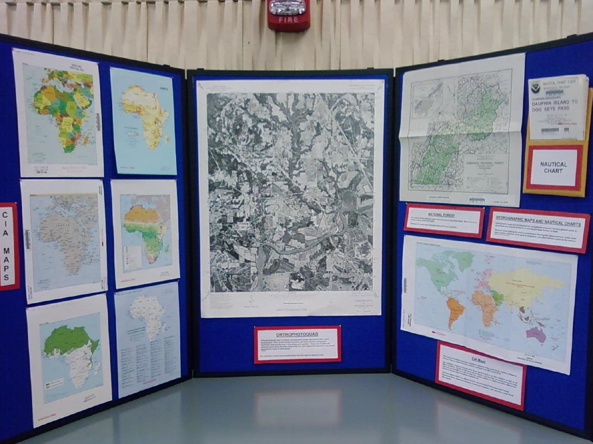
Government documents at the University of South Alabama.

Slide 34
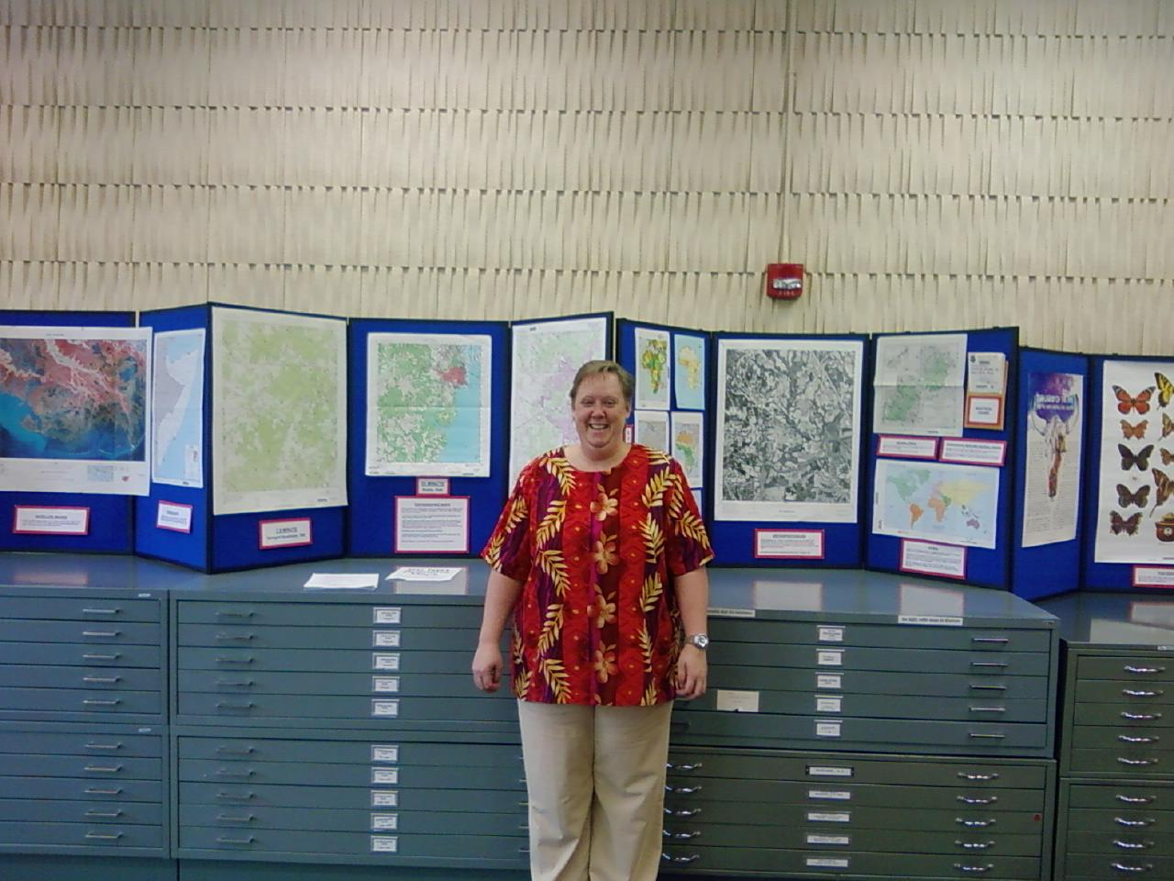
Government documents at the University of South Alabama.

Slide 35
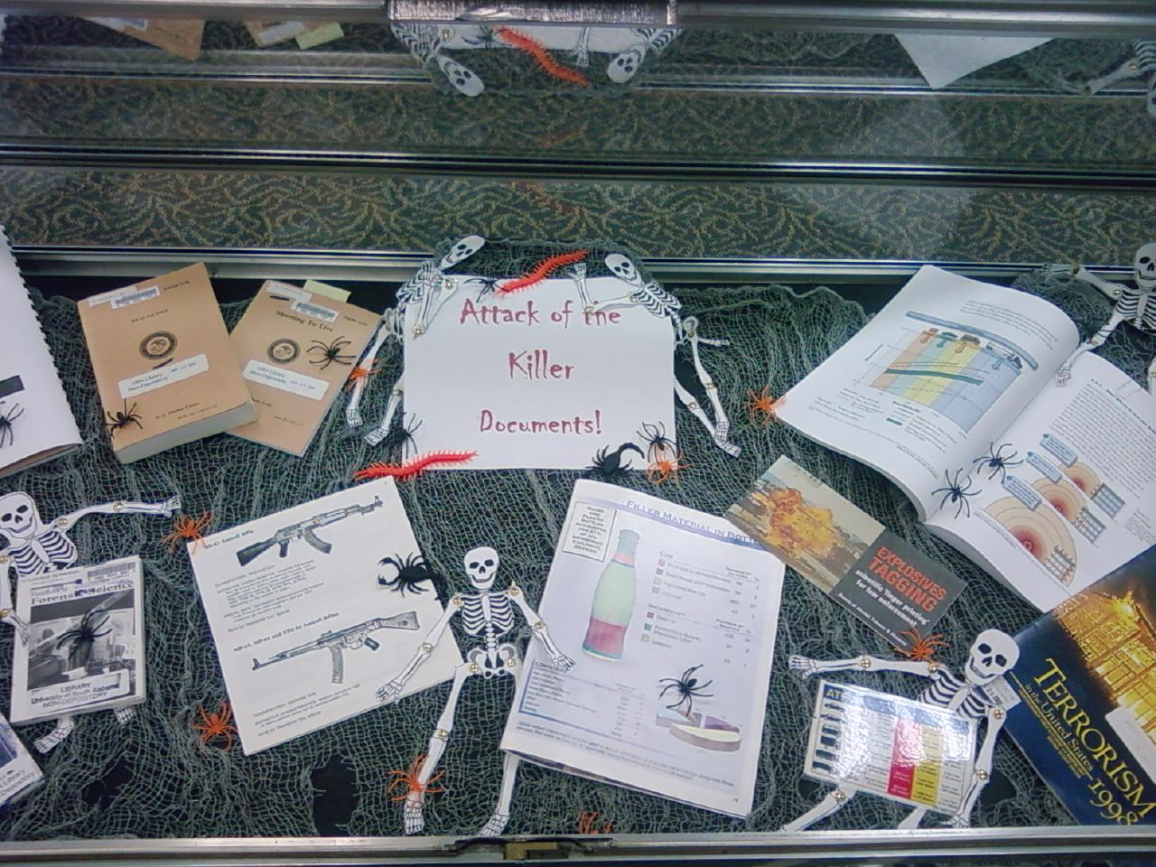
Halloween at the University of South Alabama.

Slide 36
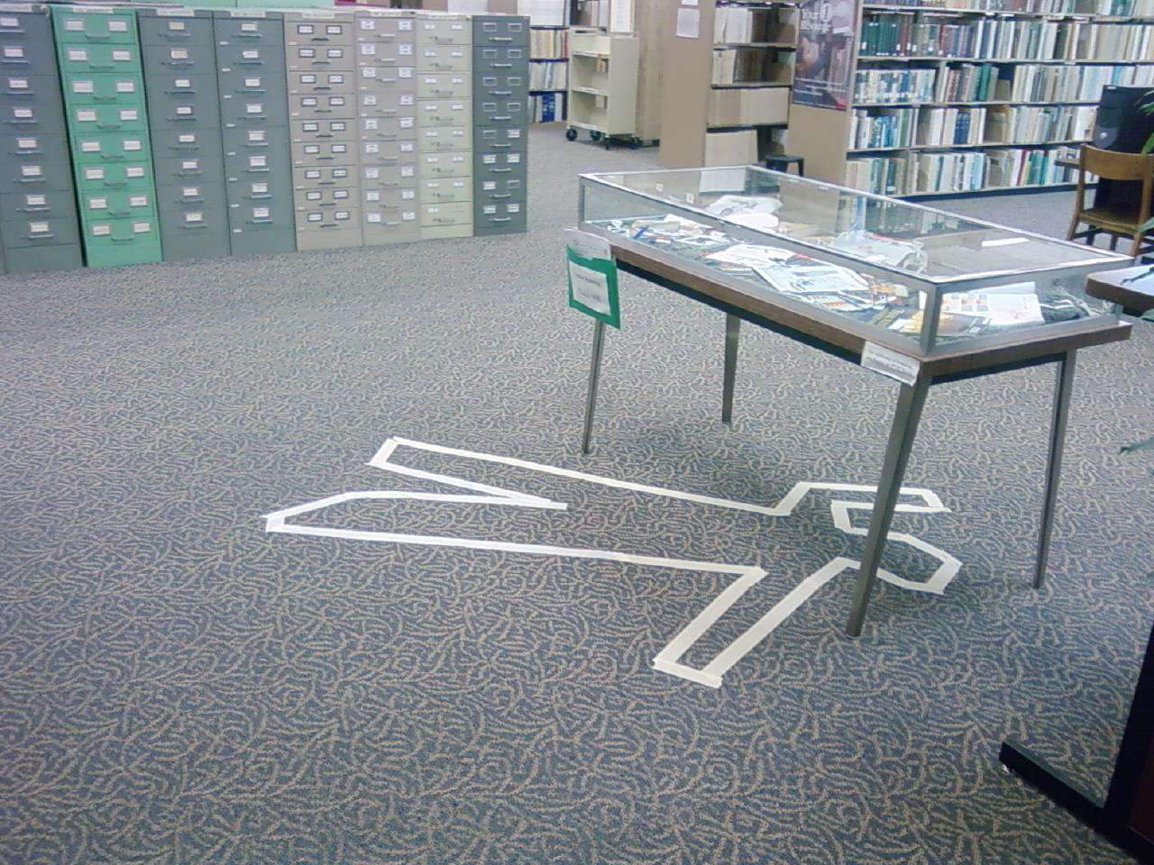
Halloween at the University of South Alabama.

Slide 37
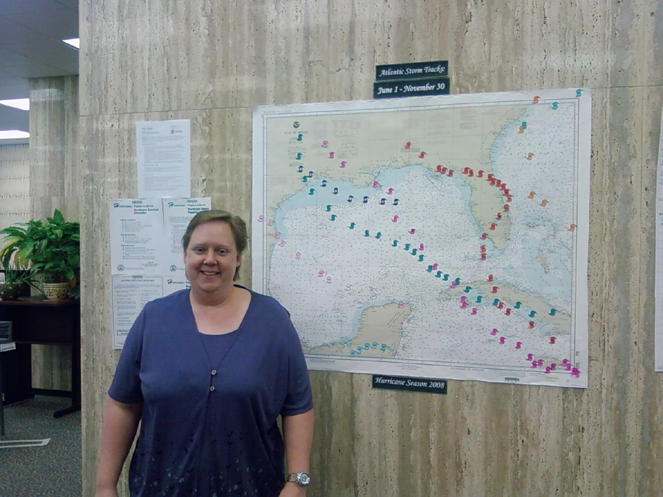
The University of South Alabama.

Slide 38
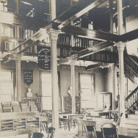
One of the earliest university libraries in University Hall during the 1899/1905 timeframe, Purdue University Libraries.

Slide 39
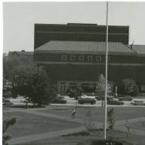
Stewart Center, site of Purdue's Humanities, Social Science, and Education Library.

Slide 40
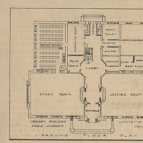
Early floor plan, Purdue University Libraries.

Slide 41
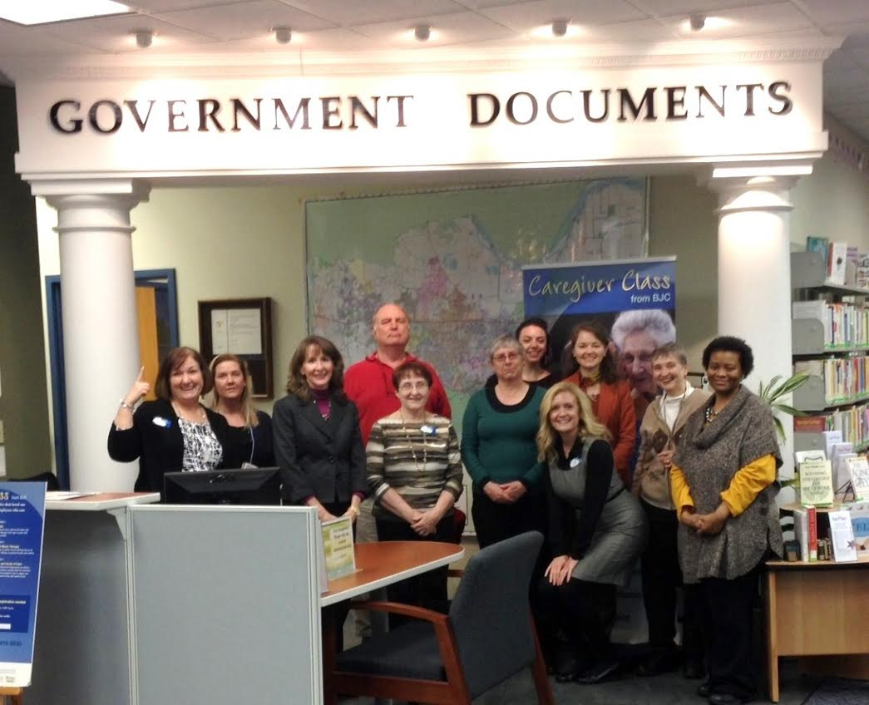
Local FDLP Meeting for Missouri Depository Librarians at Middendorf-Kredell Library in St. Charles, MO.

Slide 42
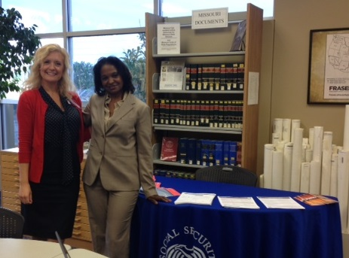
The Middendorf-Kredell Library hosting a sign-up event with Social Security Administration on Constitution Day 2014.

Slide 43
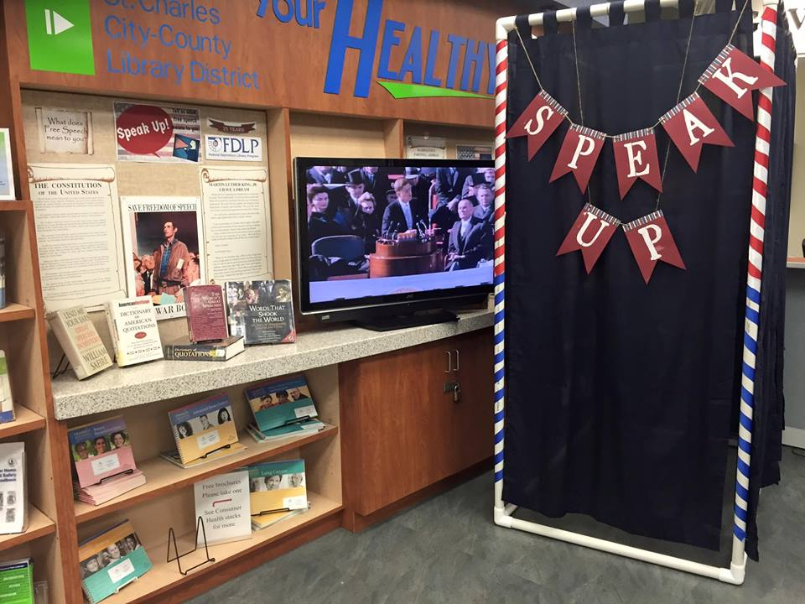
The Middendorf-Kredell Branch is celebrating 25 years in the FDLP with a Speak Up! Photo Booth.

Slide 44
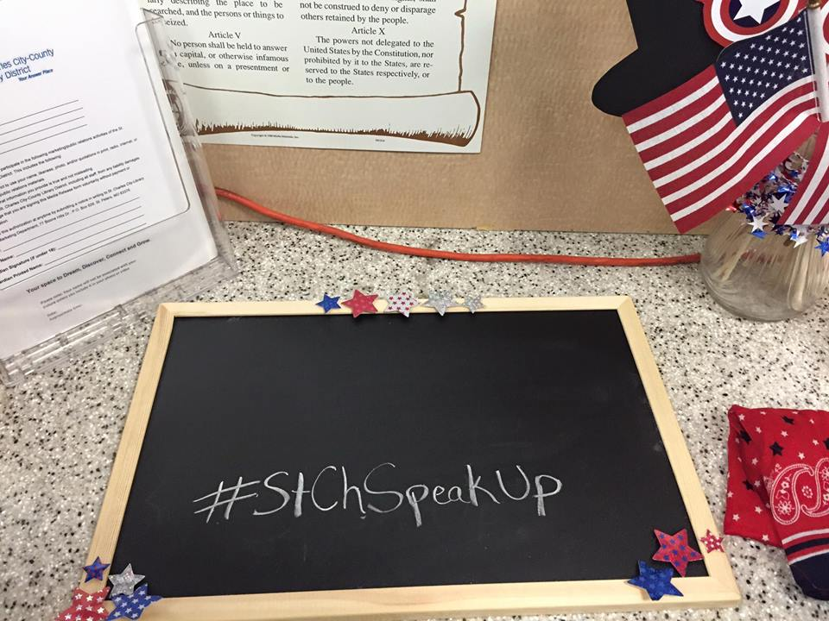
#stchspeakup is our social media hashtag for the booth, Middendorf-Kredell Library.

Slide 45
Patrons can take photos or videos about what free speech means to them, Middendorf-Kredell Library.

Slide 46
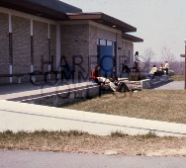
Students at old Harford Community College Library (now Maryland Hall) early 1970, before building Learning Resources Center.

Slide 47
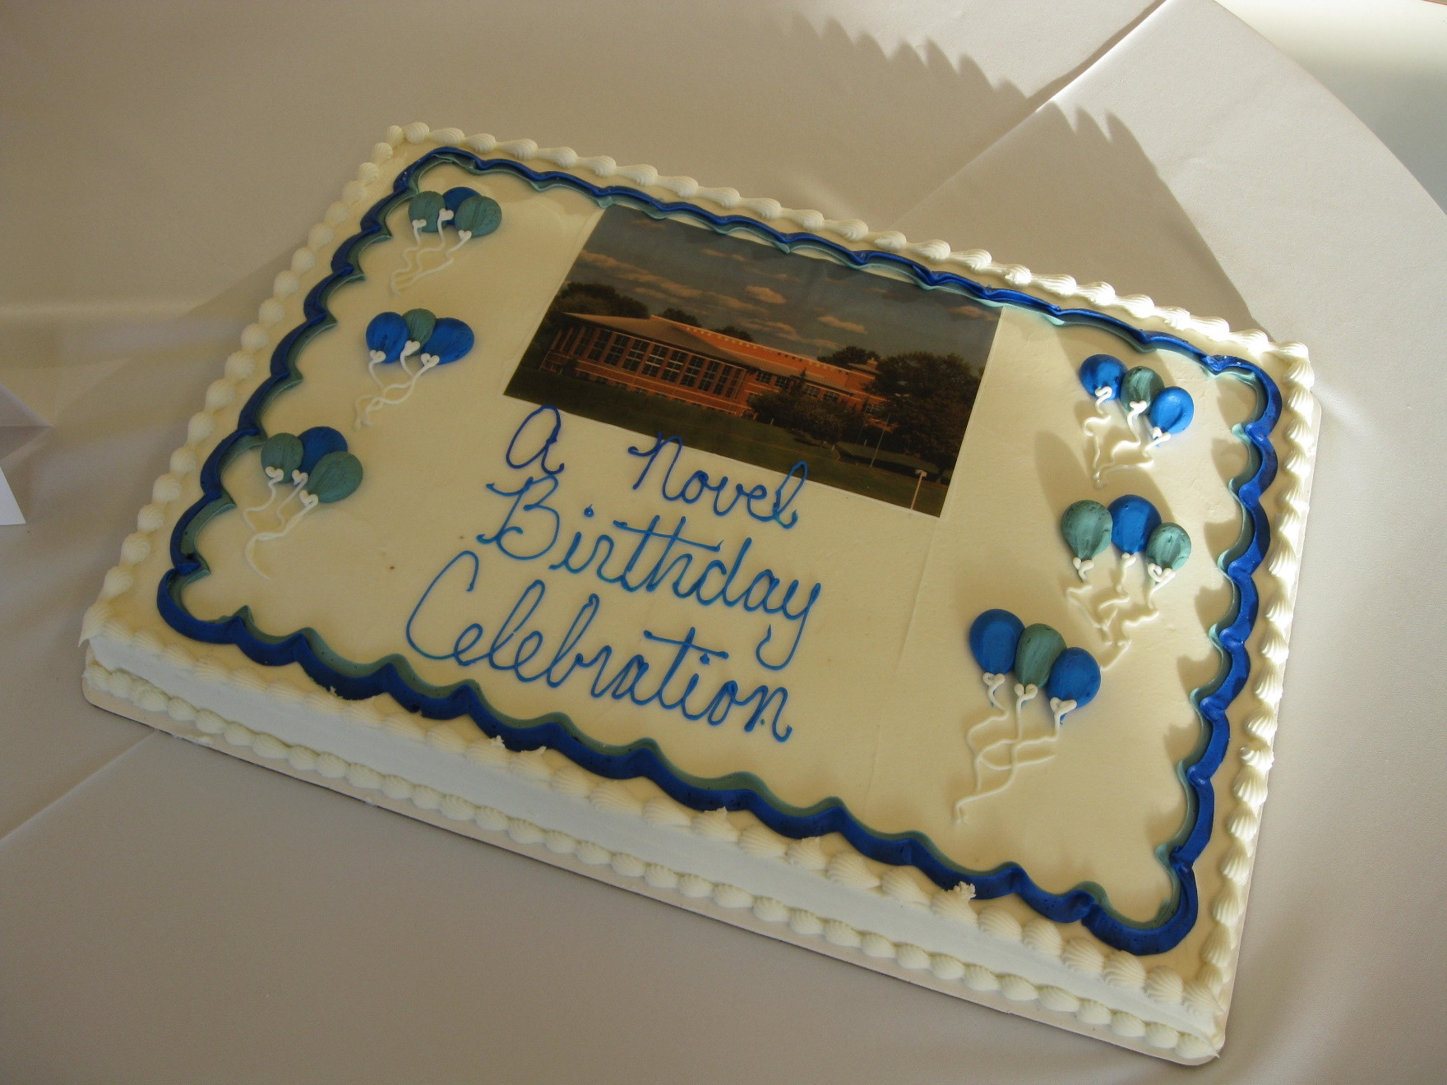
Novel Birthday Celebration for 10 years in Harford Community College Library building.

Slide 48
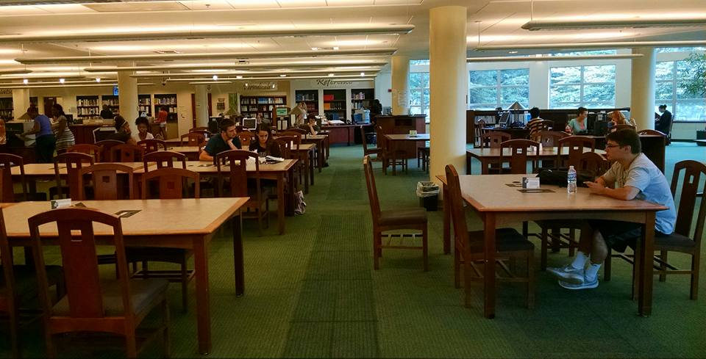
Harford Community College Library 2nd floor now 2015.

Slide 49
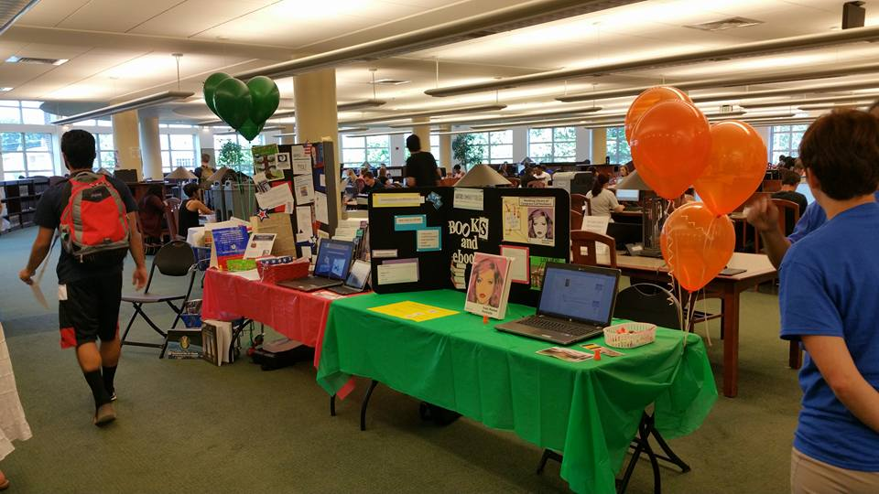
Harford Community College Library Expo with our new "Curves" shelving along the windows and more reading spaces.

Slide 50
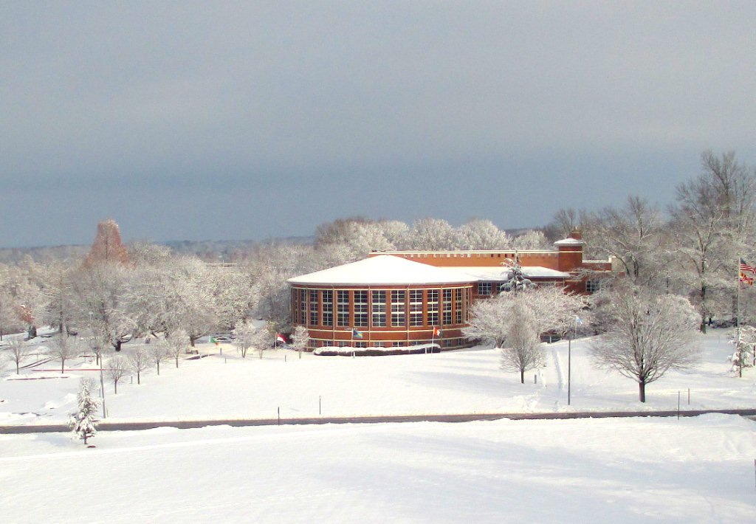
Harford Community College Library in snow 2013.

Slide 51
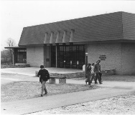
Harford Community College Learning Resources Center after 1975.

Slide 52
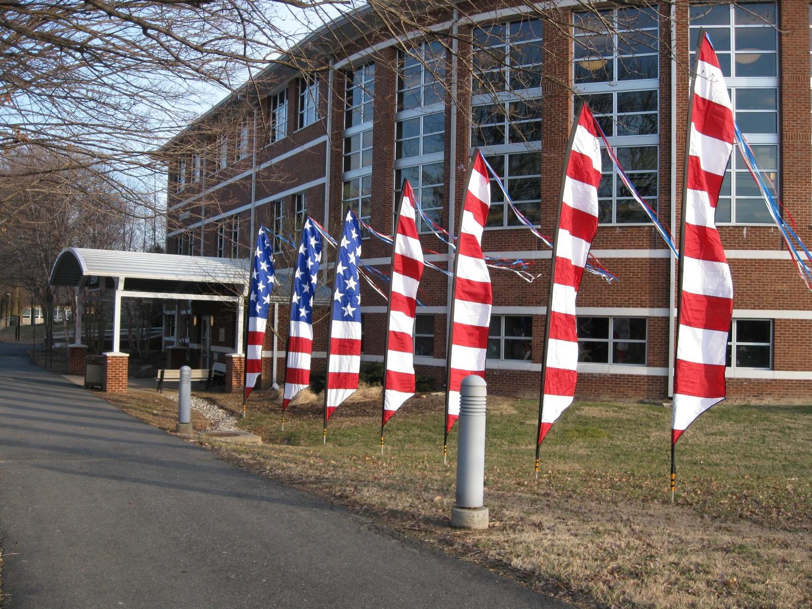
Harford Community College Library with celebration banners for Novel Birthday celebrating 10 years in building.

Slide 53
Harford Community College Library 2nd floor prior 2013.

Slide 54
Upcoming Harford Community College Library 2015 Constitution Day program.

Slide 55
Harford Community College Library Expo 2015 FDLP table.

Slide 56
Historic Government documents at Bowdoin College.

Slide 57
1822 letter transmitting certain government documents to Bowdoin College.

Slide 58
University of Virginia Alderman Library, circa 1937.

Slide 59
University of Virginia's Alderman Library main entrance hall - Memorial Hall, circa 1937.

Slide 60
Students studying in the University of Virginia's Alderman Library.

Slide 61
These might be the government documents stacks at the University of Virginia's Alderman Library, circa 1965.

Slide 62
University of Virginia's all-male undergraduates studying in Alderman Library, circa 1950 or so.

Slide 63
New technology at the University of Virginia, around 1965.

Slide 64
Government Information Day 2015 at the Indiana State Library and the closed stacks for Government documents.

Slide 65
Indiana State Library building, 1934 & 2014.

Slide 66
DePaul University Library, c. 1975.

Slide 67
John T. Richardson Library, DePaul University, 2015.

Slide 68
Cate Kellett, Yale Law School. The 2014 CFRs happened to match the book truck perfectly.

Slide 69
University of Mount Union celebrated 125 years of depository status in 2013. Display included depository items, GPO marketing materials, and the commemorative plaque.

Slide 70
University of Mount Union banner for 125th Anniversary Celebration.

Slide 71
University of Mount Union 125th Anniversary cake.

Slide 72
Display at Freshmen Library Event (Discover West Virginia University Libraries), 2011.

Slide 73
Display at Freshmen Library Event (Discover West Virginia University Libraries), 2011.

Slide 74
Compact Shelving of Government Documents, West Virginia University Libraries.

Slide 75
GovDocs Staff at Freshmen Library (Discover West Virginia University Libraries), 2011.

Slide 76
Display of Government Documents featuring Sept. 11, West Virginia University Libraries.

Slide 77
Brown University celebrates 150 years as a Federal Depository Library, 1861 – 2011.

Slide 78
Manning Hall, Brown University Library in 1861.

Slide 79
Manning Hall, Brown University Library in 1861.

Slide 80
Creative promotion from Carelron College's Gould Library.

Slide 81
Sig Weinhold, Head of Government Documents, seated in Cleveland Public Library's Documents Collection, 1978.

Slide 82
Cleveland Public Library, 1994.

Slide 83
Another view of the Cleveland (Ohio) Public Library's Government Documents Department in 1994.

Slide 84
The marble-covered walls of the Cleveland (Ohio) Public Library's Government Documents Department in 1994. The FDLP logo can be seen on the open door.

Slide 85
Sig Weinhold, Head of Government Documents 1978. Book trucks emblazoned with the department's designation surround his desk.

Slide 86
A view through the doors of Cleveland (Ohio) Public Library's Documents Collection in 1978. Seen handling calls are Sig Weinhold (right), head of the collection at the time, and Cathy Williams (left, partly obscured by the door), a long-time staff member.

Slide 87
Kelvin Smith Library, home of Government Documents at Case Western Reserve University.

Slide 88
Thwing Library of Western Reserve University (1934-56.) Image property of Case Western Reserve University Archives.

Slide 89
Hatch Library of Western Reserve University (1913-34). Image from Case Western Reserve University Archives.

Slide 90
Freiberger Library of Western Reserve University (1956-96). Image property of Case Western Reserve University Archives.

Slide 91
A student studying at Freiberger Library. Image property of Case Western Reserve University Archives.

Slide 92
Government information comes in all kinds of shapes and sizes. Hardin-Simmons University's Richardson Library.

Slide 93
Display promoting the Decennial Census. Hardin-Simmons University's Richardson Library.

Slide 94
Display for the 2008 Presidential election. Hardin-Simmons University's Richardson Library.

Slide 95
Display celebrating 70th year as a Federal Depository, Hardin-Simmons University's Richardson Library.

Slide 96
Simmons College library in 1901, later became Hardin-Simmons University, and its library became a Congressionally appointed selective Federal Depository (0612) in 1945.

Slide 97
Hardin-Simmons University's Richardson Library today offers access on site and online to both tangible and digital government information and documents in its Federal Depository collection.

Slide 98
Main collection back to 1980, Missouri Southern State University.

Slide 99
Spiva Library at Missouri Southern State University under construction in 1960s.

Slide 100
Spiva Library building, Missouri Southern State University.

Slide 101
Spiva Library at Missouri Southern State University under construction in 1960s.

Slide 102
Mr. George A. Spiva in front of the library, Missouri Southern State University.

Slide 103
Library staff at Circulation desk 1980, Missouri Southern State University.

Slide 104
Lowell Heiny Library 1967, Night View, Mesa College (now Colorado Mesa University).

Slide 105
Lowell Heiny Library 1975, Exterior View, Mesa College (now Colorado Mesa University).

Slide 106
Black History Month and Government documents at Southern Illinois University Carbondale.

Slide 107
Civil War display at Southern Illinois University Carbondale.

Slide 108
Morris Library's 75th Anniversary, 2007.

Slide 109
Constitution Day at Southern Illinois University Carbondale.

Slide 110
Student worker at Government Documents Table, New students library orientation, Southern Illinois University Carbondale.

Slide 111
Promoting the depository library at Southern Illinois University Carbondale.

Slide 112
Constitution Day at Southern Illinois University Carbondale.

Slide 113
Government Documents Collections, Morris Library, Southern Illinois University Carbondale, 2015.

Slide 114
Constitution Day at Southern Illinois University Carbondale.

Slide 115
University of Mississippi Library in 1950s.

Slide 116
University of Mississippi west entrance spring 2015

Slide 117
University of Mississippi student studying in library 1998.

Slide 118
University of Mississippi Government docs staff, 2005.

Slide 119
University of Mississippi Lyceum seen through Library east entrance window 1990.

Slide 120
University of Mississippi studying in library 1998.

Slide 121
University of Mississippi student assistant (Iraq War vet) birthday party, 2007.

Slide 122
University of Mississippi student processing GPO shipment at desk, 2009.

Slide 123
University of Mississippi student processing GPO shipment at desk, 2009.

Slide 124
University of Mississippi library exhibit cases, 2000.

Slide 125
University of Mississippi Government docs staff helping patron, 1987.

Slide 126
University of Mississippi Government docs staff helping patron, 1987.

Slide 127
University of Mississippi east entrance snow day 2015.

Slide 128
University of Mississippi Government Docs Librarian, Laura Harper, in stacks, 2015.

Slide 129
University of Mississippi Faulkner quote under skylight, 2015.

Slide 130
University of Mississippi Government docs staff, Rachel Peck, pulling map, 2015.

Slide 131
University of Mississippi sunlit library east entrance, 2015.

Slide 132
University of Mississippi west entrance spring 2015.

Slide 133
University of Mississippi student shelving docs, 2015.

Slide 134
University of Mississippi census exhibit, 2010.

Slide 135
University of Mississippi Library in 1950s.

Slide 136
Kelley Center for Government Information, Fondren Library, Rice University, newly remodeled, 2015

Slide 137
Silly Government Titles (2007) and Constitution Day Contests (2012), Kelley Center, Rice University.

Slide 138
Kelley Center entry in campus holiday decorating contest, 2011, Rice University. Got campus thinking about government information.

Slide 139
Library Halloween decorating contest 2007. Staff still remembers we use SuDoc classification from Siu Min Yu dressing as a doctor.

Slide 140
Kelley Center for Government Information, Fondren Library, Rice University, newly remodeled, 2015.

Slide 141
Booth at Yearly International Student Day Fair at Fondren Library, Rice University, 2014.

Slide 142
University of New Hampshire Dimond Library ca.1994 Federal depository collection. Credit: Milne Special Collections and Archives Department.

Slide 143
University of N.H. Dimond Library 2015. Government Information circulating collection.

Slide 144
University of N.H. Dimond Library 2015. DocsRef collection, facing Map Room with seating.

Slide 145
University of N.H. Dimond Library 2015. Government documents on display.

Slide 146
University of N.H. Dimond Library ca.1994 Federal depository collection. Credit: Milne Special Collections and Archives Department, University of New Hampshire Library, Durham, NH.

Slide 147
University of N.H. Dimond Library ca.1994 Government Documents Dept. office. Credit: Milne Special Collections and Archives Department, University of New Hampshire Library, Durham, NH.

Slide 148
University of N.H. Dimond Library 2015. Government Information homepage's Featured Resource.

Slide 149
Christmas at the Dayton Public Library, date unknown.

Slide 150
Reference Desk, Dayton Public Library, 1922.

Slide 151
Crime and blood go together for exhibit during Cybercrime Awareness Month. Ohio State Libraries.

Slide 152
The University of South Alabama's 40th Anniversary Celebration.

Slide 153
The University of South Alabama's 40th Anniversary Celebration.

Slide 154
The University of South Alabama's 40th Anniversary Celebration.

Slide 155
The University of South Alabama's 40th Anniversary Celebration.

Slide 156
The University of South Alabama's 40th Anniversary Celebration.

Slide 157
The University of South Alabama's 40th Anniversary Celebration.

Slide 158
The University of South Alabama's 40th Anniversary Celebration.

Slide 159
The University of South Alabama's 40th Anniversary Celebration.

Slide 160
The University of South Alabama's 40th Anniversary Celebration.

Slide 161
The University of South Alabama's 40th Anniversary Celebration.

Slide 162
The University of South Alabama's 40th Anniversary Celebration.

Slide 163
The University of South Alabama's 40th Anniversary Celebration.

Slide 164
Documents shelves circa 1985, South Dakota School of Mines & Technology.

Slide 165
Perfect boxes for storing CD-ROMs or DVDs. South Dakota School of Mines & Technology.

Slide 166
Moving, migration of materials to a different floor, along with reclassification from SuDocs to LC, a long term, ongoing projects - South Dakota School of Mines & Technology.

Slide 167
Library in 1970, Devereaux Library Building, South Dakota School of Mines & Technology.

Slide 168
Library in 1910, South Dakota School of Mines & Technology .

Slide 169
Library in 1941, O'Harra Memorial Building, South Dakota School of Mines & Technology.

Slide 170
Western Washington University celebrated its 50th anniversary as a depository in 2013 with lectures by faculty, displays, and a cake.

Slide 171
2002 University of North Texas display "Saluting our Veterans.“

Slide 172
Pauline Ward, served as the first Documents Librarian at University of North Texas, 1948-1953.

Slide 173
Velma Lee Cathey, Documents Librarian at University of North Texas, 1953-1974.

Slide 174
Melody Kelly, Documents Librarian, 1974-2001, University of North Texas.

Slide 175
Cathy Hartman, Documents Librarian, 2001-2003, University of North Texas.

Slide 176
University of North Texas Docs Department 2006.

Slide 177
Superintendent of Documents, Mary Alice Baish visits the Eagle Commons Library, 2015, University of North Texas.

Slide 178
University of North Texas Docs Department 2010.

Slide 179
University of North Texas' 50 Shades of (Government Document) Grey, February 2015.

Slide 180
Former University of North Texas Gov Docs Librarian, now Assistant Dean, Suzanne Sears goes batty in 2013.

Slide 181
Kraemer Family Library, University of Colorado - Colorado Springs, with Pikes Peak in the background.

Slide 182
Geography students are studying in Government Information, Alkek Library at Texas State University.

Slide 183
Rory Elliott, Specialized Collections Librarian, is showing a Water Resources class how to use USGS Map Locator, Alkek Library at Texas State University.

Slide 184
Students are studying in our Map Collection area, Alkek Library at Texas State University.

Slide 185
Students in the Government Information compact shelving area, Alkek Library at Texas State University.

Slide 186
Arbor Day display, Alkek Library at Texas State University.

Slide 187
Our GIS Services Specialist is showing ArcGIS to a student, Alkek Library at Texas State University.

Slide 188
Alkek Library at Texas State University (2015).

Slide 189
Alkek Library at Texas State University (2015).

Slide 190
Alkek Library at Texas State University. Staff choose government documents to highlight.

Slide 191
Alkek Library at Texas State University (2015). Texas State University's Facebook page.

Slide 192
Alkek Library at Texas State University (2015). New Arrivals display.

Slide 193
Alkek Library at Texas State University (2015). Map collection.

Slide 194
Alkek Library at Texas State University (2015). USGS topographic maps recently printed for patrons.

Slide 195
Alkek Library at Texas State University (2015). Display on documents regarding National Advisory Committee for Aeronautics.

Slide 196
75th Anniversary Events - Federal Depository Library at the University of Louisiana at Lafayette.

Slide 197
75th Anniversary Events - Federal Depository Library at the University of Louisiana, Lafayette.

Slide 198
75th Anniversary - Federal Depository Library at the University of Louisiana, Lafayette.

Slide 199
75th Anniversary - Federal Depository Library at the University of Louisiana at Lafayette.

Slide 200
Chicago Public Library's Government Publications staff. CPL Communicator, March 1983.

Slide 201
25 N. Michigan Avenue was the first location at Chicago Public Library where the Government Publications Department brought the depository documents into a separate collection. Chicago Public Library Annual Report, 1979.

Slide 202
Civics Room at the old central library, Chicago Public Library shows patrons using government information. Undated photo, Chicago Public Library Archives.

Slide 203
Civics Room in the old central library building provided access to depository materials and patents. Undated photo, Chicago Public Library Archives.

Slide 204
Chicago Public Library Display.

Slide 205
Prior to the creation of the Government Publications Department, depository pamphlets were filed with the Vertical File Pamphlet Collection. Undated photo, Chicago Public Library Archives.

Slide 206
The Civics Department was the subject of a series of photos for a Chicago Public Library Scrapbook. Charles Lhotka was the Chief of the Civics Dept. Chicago Public Library Archives, 1916.

Slide 207
Jessie Woodford Lyman, also known as the "Doc Lady", Principal Cataloger of the Civics Dept. Chicago Public Library Archives, 1916.

Slide 208
Edith Covalt, Principal assistant, Civics Department. Chicago Public Library Archives, 1916.

Slide 209
Ruth Goldstone, Clara Barnes, junior assistants, Civics Department. Chicago Public Library Archives, 1916.

Slide 210
Documents on the shelves, Civics Department. Chicago Public Library Archives, 1916.

Slide 211
At work in the Civics Department. Clara Barnes, Jessie Woodford, Ruth Goldstone. Chicago Public Library Archives, 1916.

Slide 212
Display of interesting documents. Chicago Public Library Archives, 1916.

Slide 213
Photo of the Documents staff enjoying a summer afternoon in the country. Marion Anderson, Winifred Edwards, Katherine Kenyon, Jessie Woodford Lyman, Sarah J. Kerns. Chicago Public Library Archives, 1924.

Slide 214
Government Publications Department Staff in 2010. Standing: Desislava Battersby, Sarah Dysken, Lynne Kiviluoma, Yvonne Perez, Tom Mikula, Shah Tiwana. Seated: Shenita Mack, Bonnie Hines, Sarah Erekson. Chicago Public Library .

Slide 215
Serials processing from around 1939 at the School of Mines and Metallurgy Library in Rolla, MO.

Slide 216
Cataloging and Serials Department Office, School of Mines and Metallurgy Library.

Slide 217
Reading Room, School of Mines and Metallurgy Library.

Slide 218
A Black History Month display in our department, Poplar Creek Public Library.

Slide 219
A civil rights display in our department, Poplar Creek Public Library.

Slide 220
A Civil War display in our department, Poplar Creek Public Library.

Slide 221
A military history display in our department, Poplar Creek Public Library.

Slide 222
Our Government Documents Department, as it looks today - Poplar Creek Public Library.

Slide 223
A display about the Constitution in our department, Poplar Creek Public Library.

Slide 224
How our library looked when we became a depository, Poplar Creek Public Library.

Slide 225
Our Government Documents Department, as it looks today - Poplar Creek Public Library.

Slide 226
How our Government Documents desk used to look, Poplar Creek Public Library.

Slide 227
Middendorf-Kredell, 2015. Reception closing an exhibit on the National Library of Medicine.

Slide 228
Middendorf-Kredell of the St. Charles City-County Library District, 2014. Healthcare reform throughout history.

Slide 229
Middendorf-Kredell of the St. Charles City-County Library District, 2014. Healthcare reform throughout history.

Slide 230
Middendorf-Kredell, 2015. Honest Abe is our mascot for Government Documents and he wanted to remind everyone about our Supreme Court documents.

Slide 231
Fondren Library at Texas’ Southern Methodist University in the 1960s.

